Slide 1
Capture Methods, PoolSeq, and Low-Coverage Whole Genome Sequencing
BIO 594-
URI 4/11/2018

Slide 2

Outline
A brief guide to multiple population genomic methods
Targeted Capture Methods
Ultra Conserved Elements
Exome Capture
Expressed Exome Capture (EecSeq)
Pooled Sequencing (PoolSeq)
Low Coverage Whole Genome Sequencing (lcWGS)
Live Coding
EecSeq data
lcWGS and genotype-likelihood based analyses
~ 30 mins for 1-on-1 final project consultations
BIO 594

Slide 3
The genomic era: powered by NGS

Slide 4
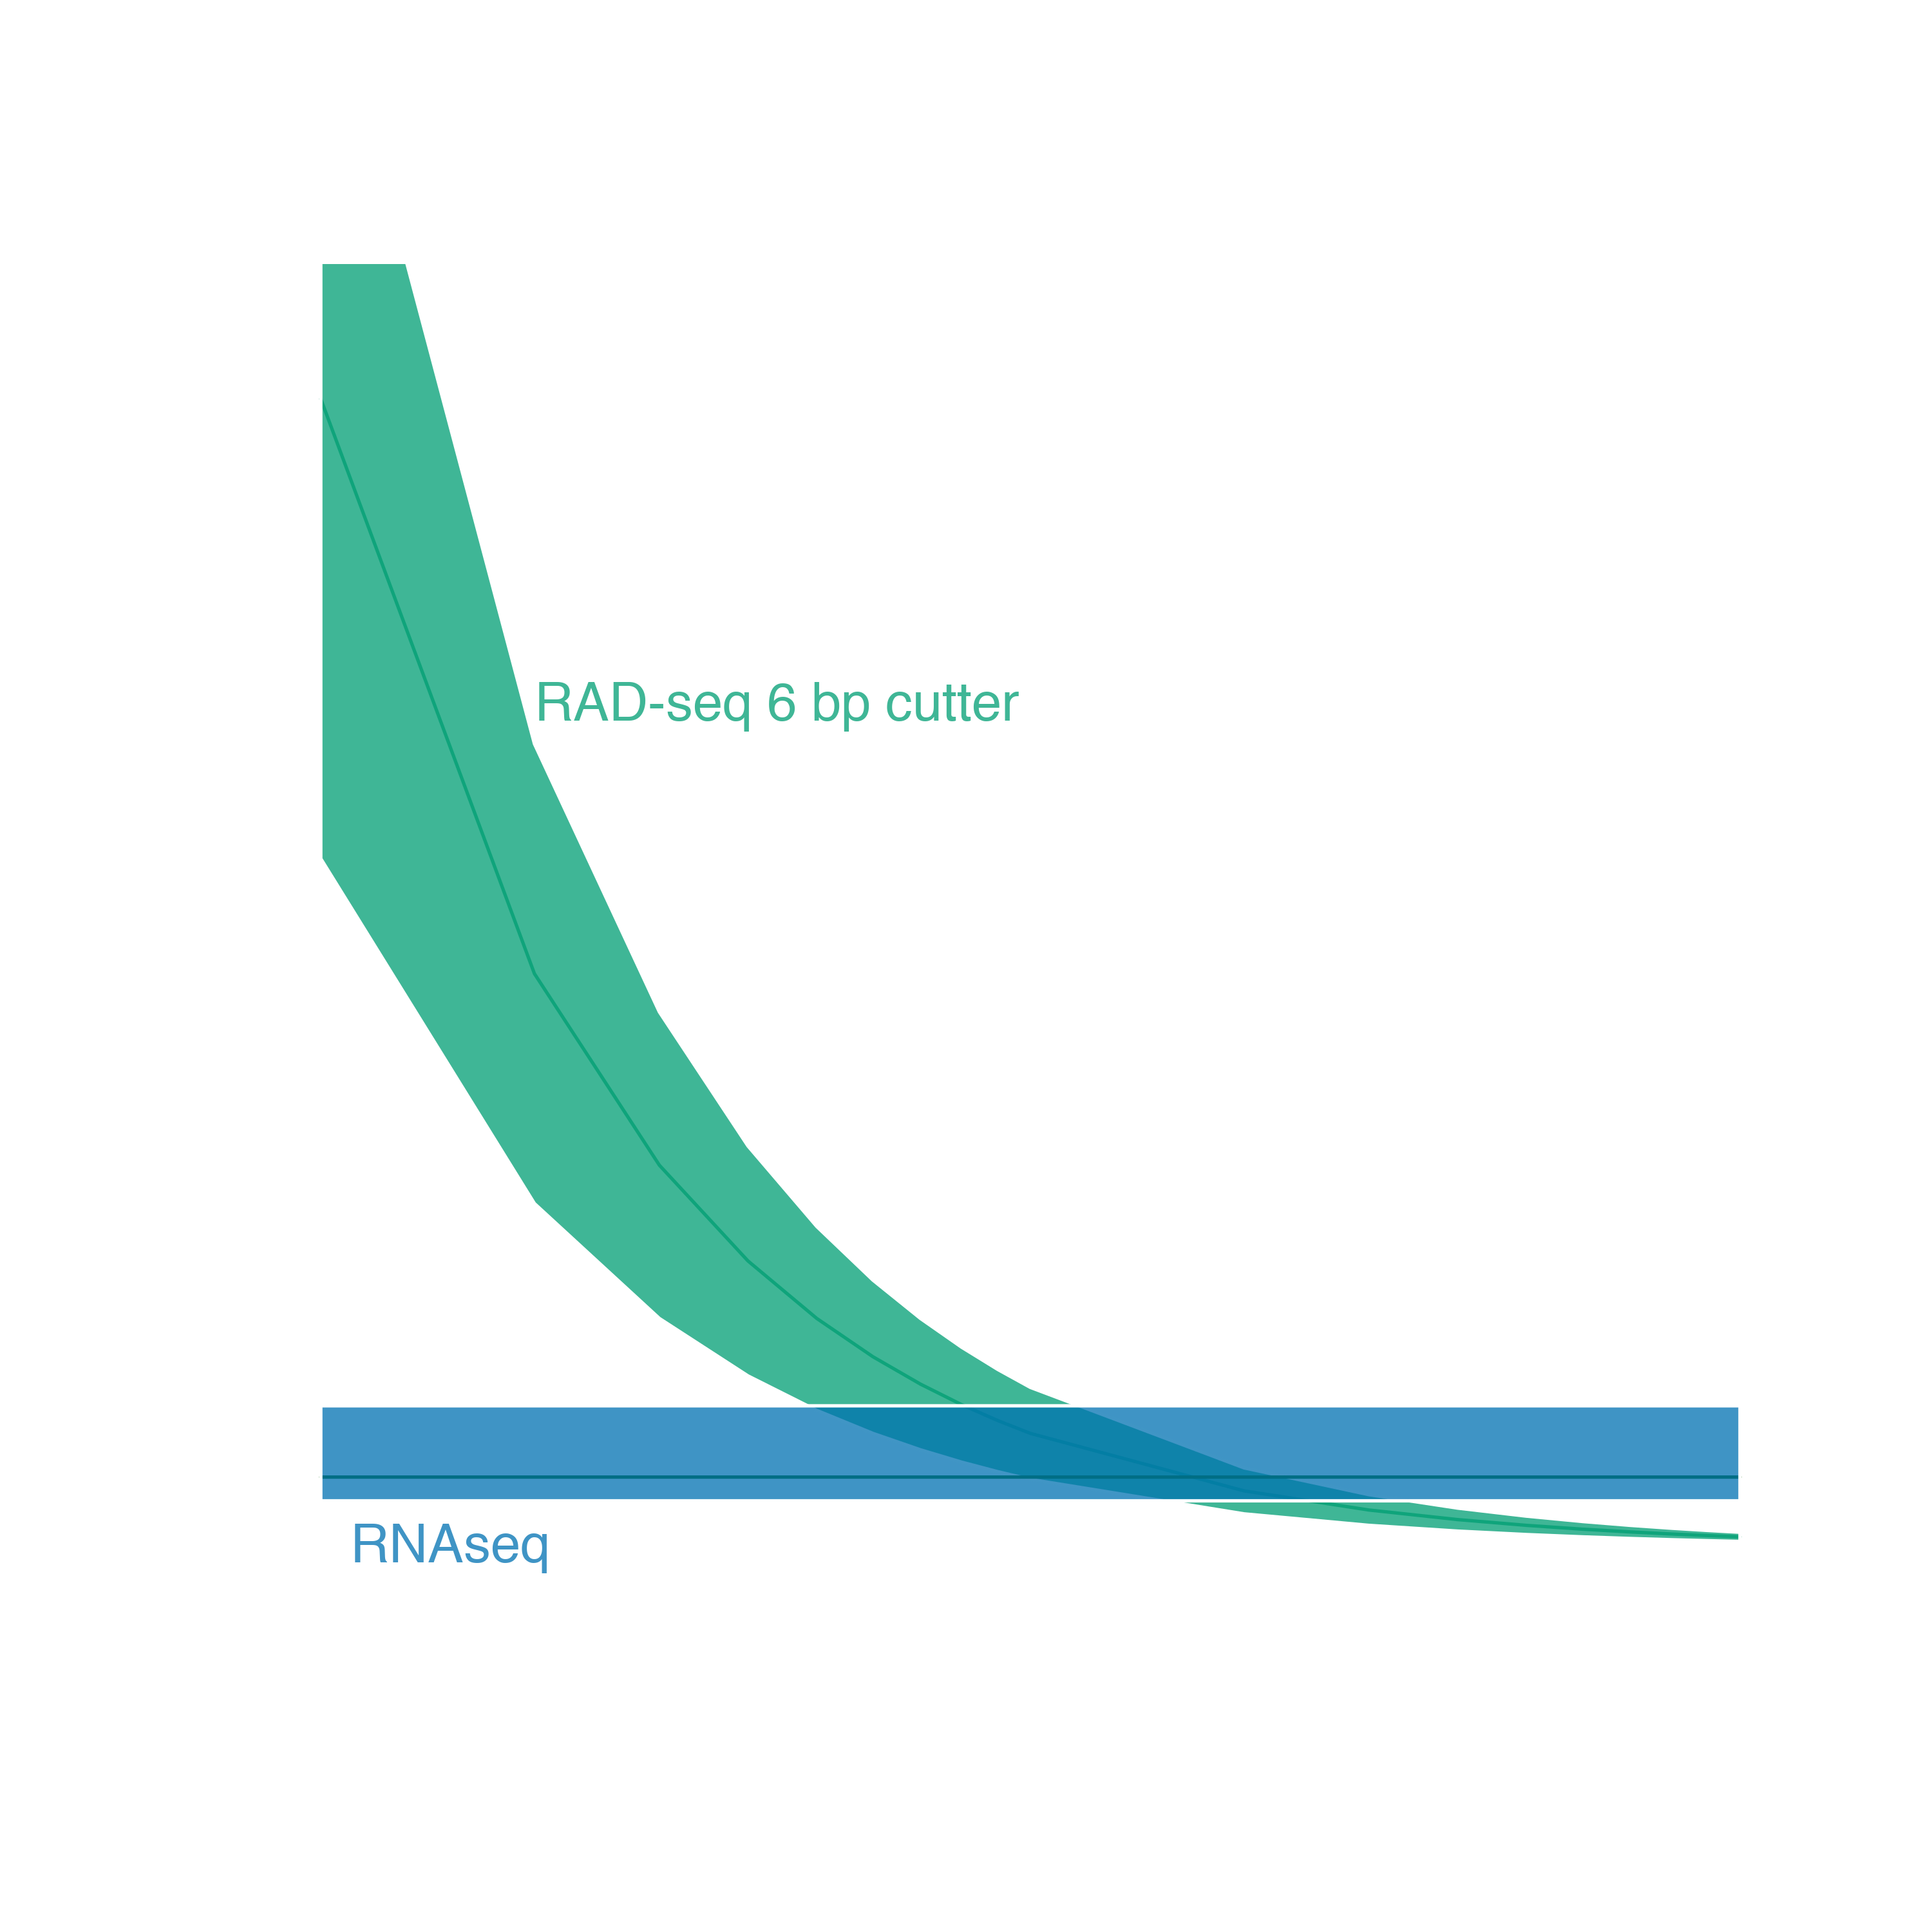
Genome reduction options
No existing genomic resources
RNAseq
RADseq
Adapted from Lowry et al. 2016

Slide 5
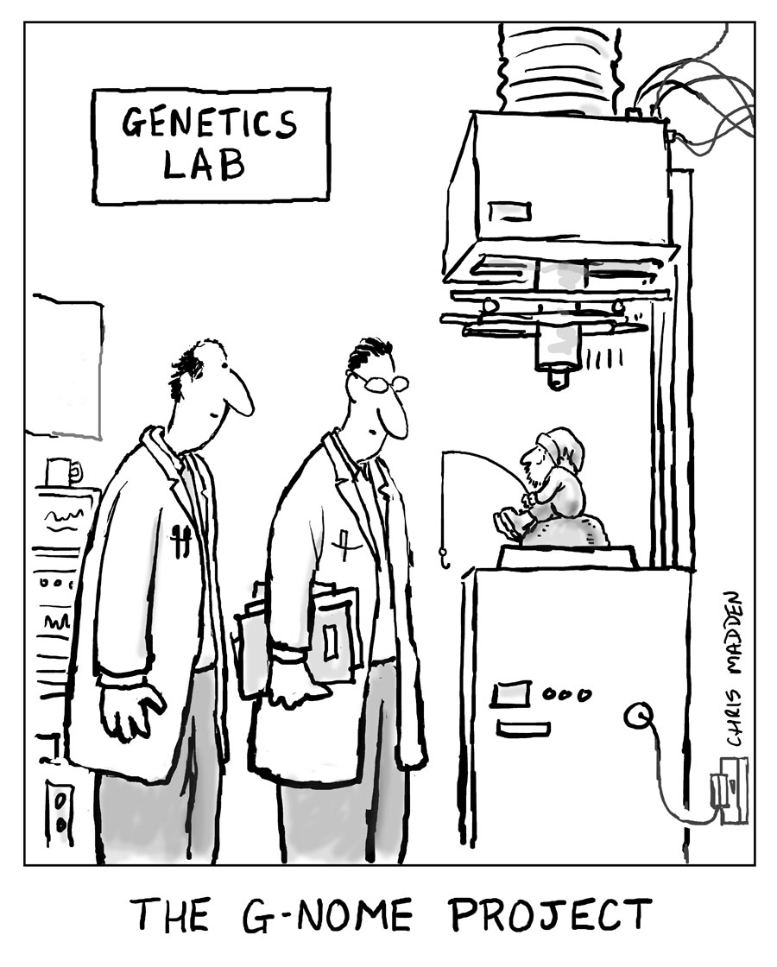
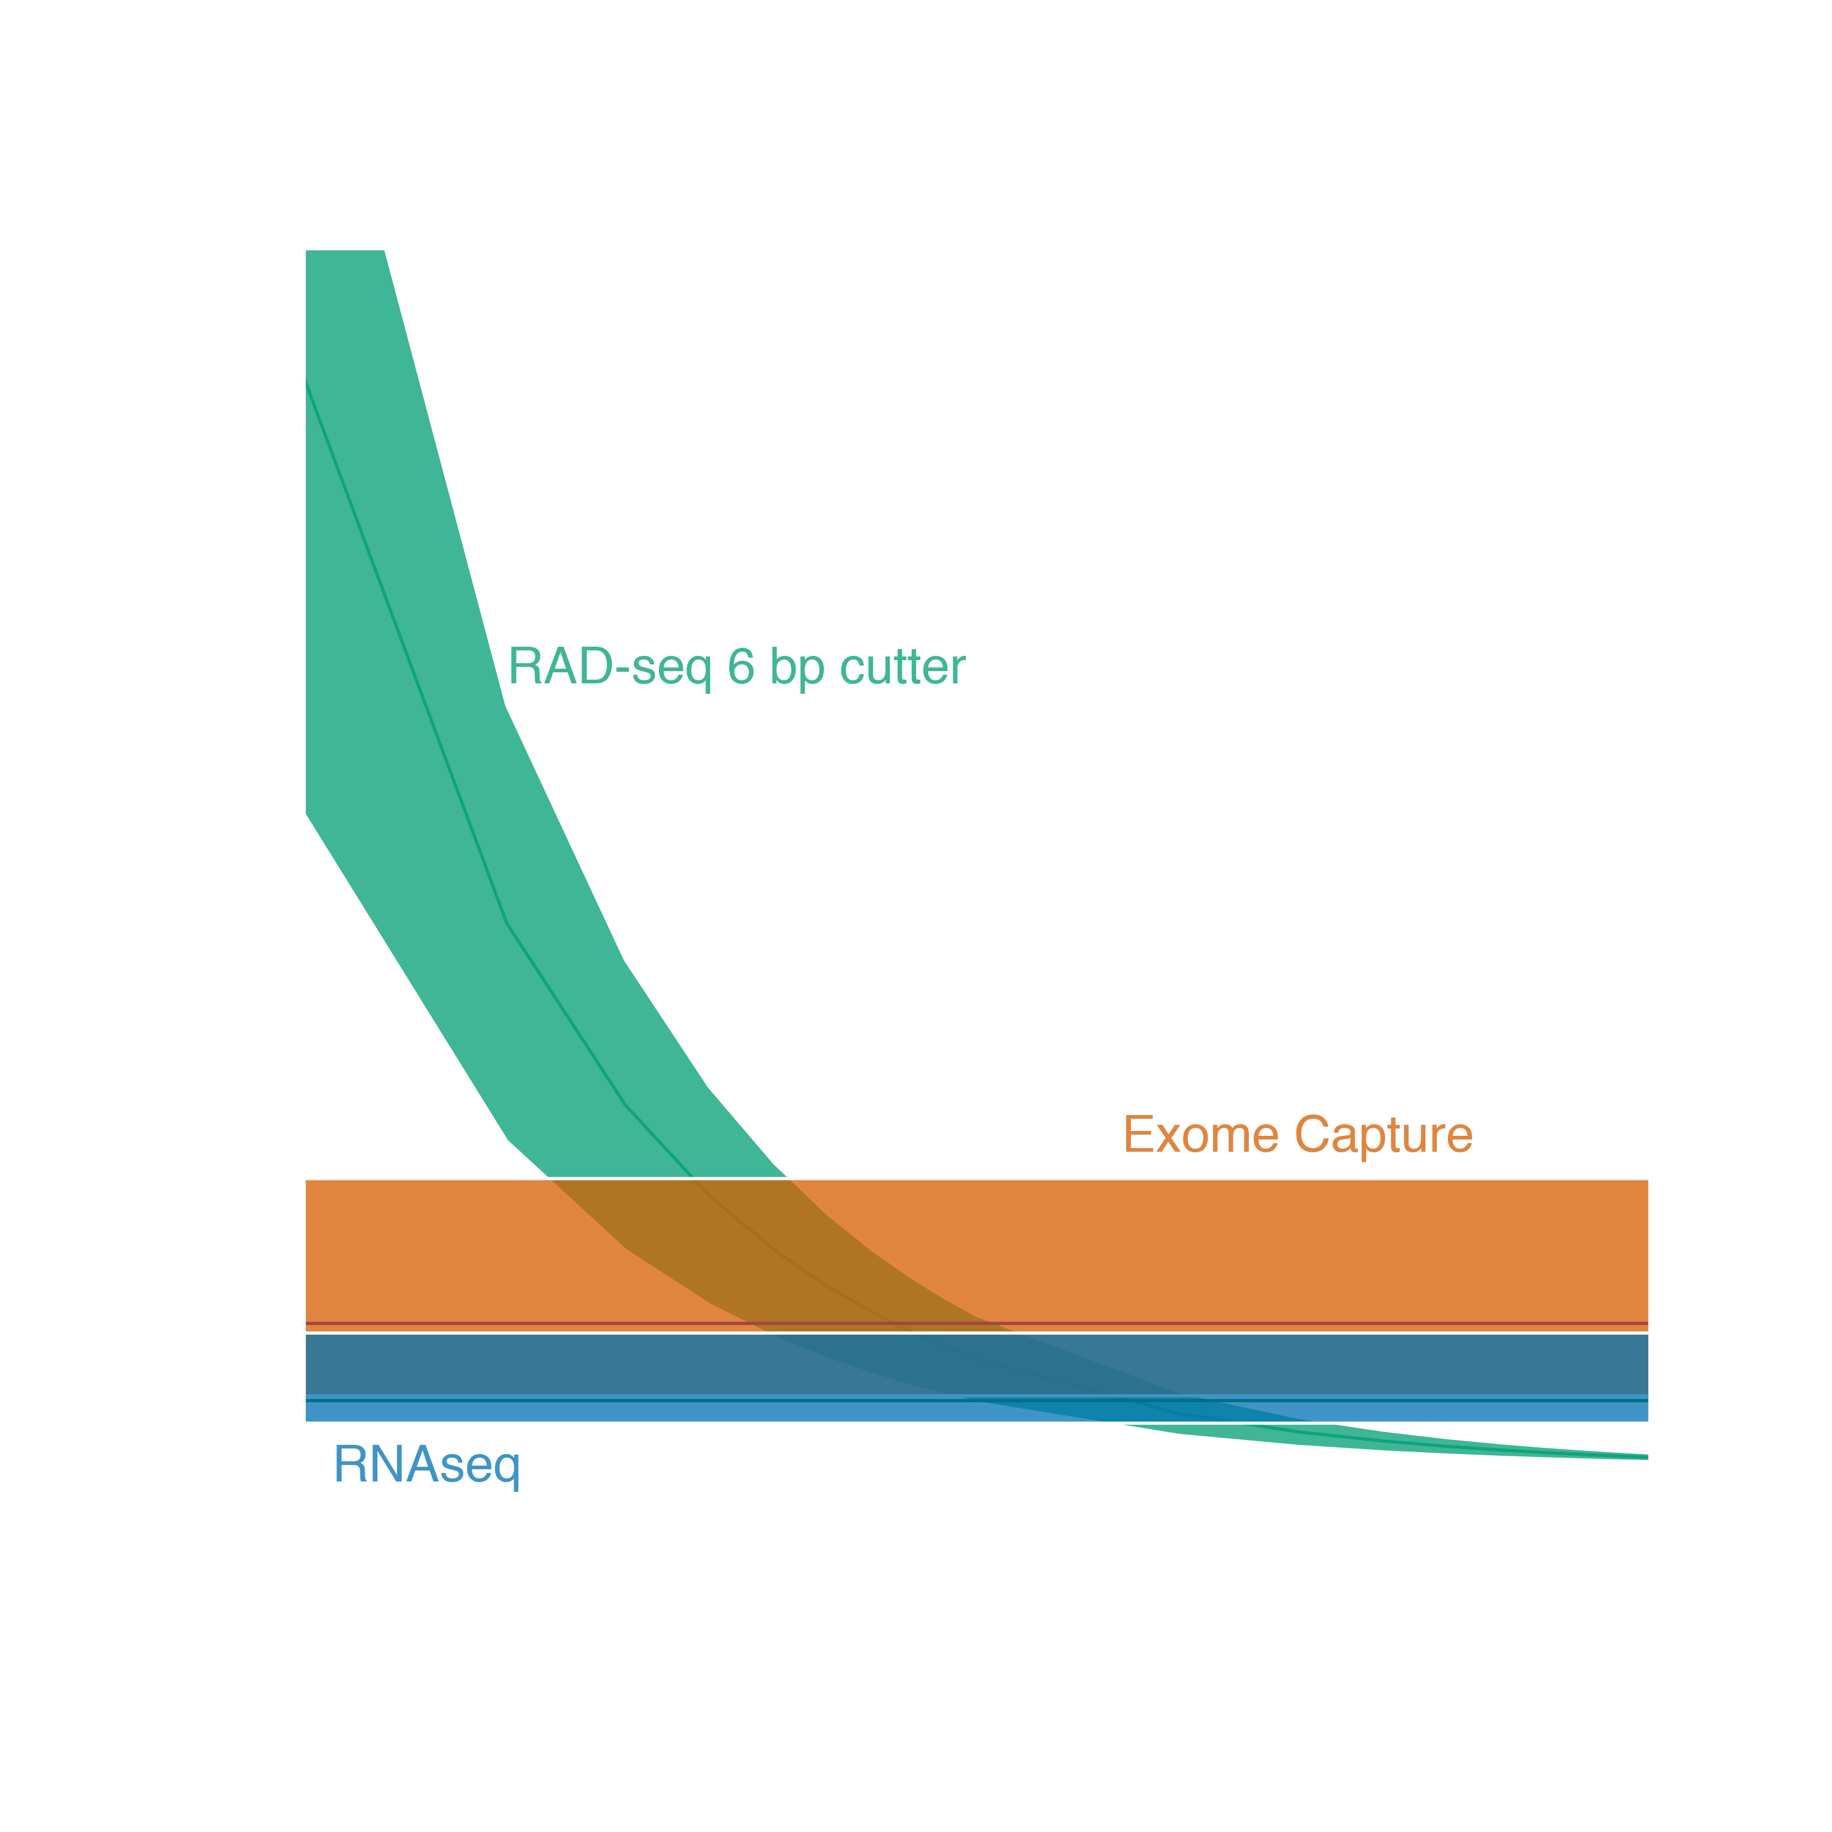
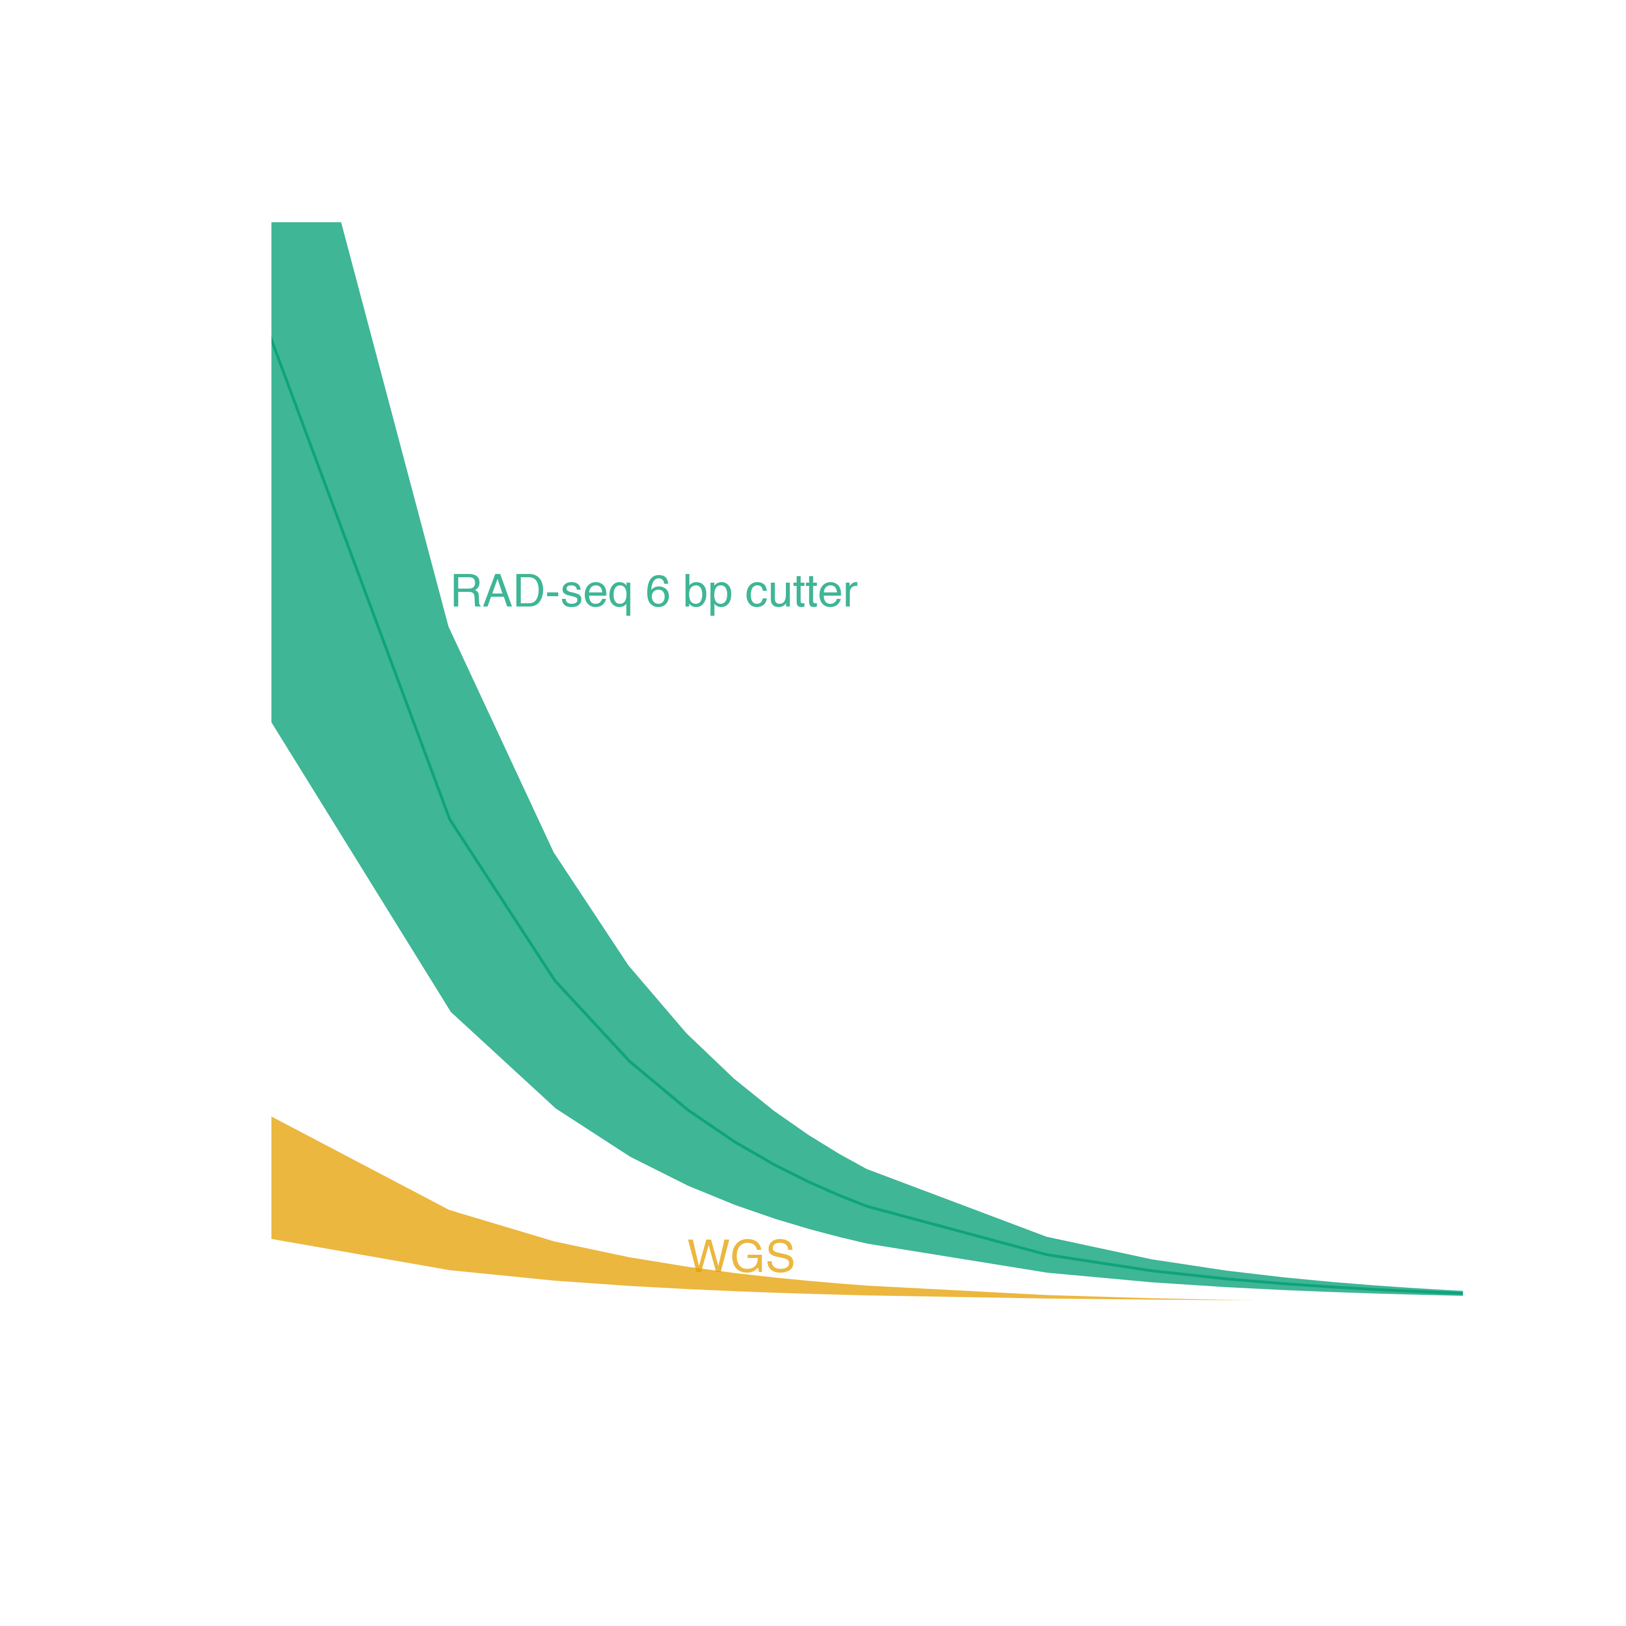
Genome reduction options
With genomic resources
Targeted capture
Ultra Conserved Elements
Exome Capture
Adapted from Lowry et al. 2016

Slide 6
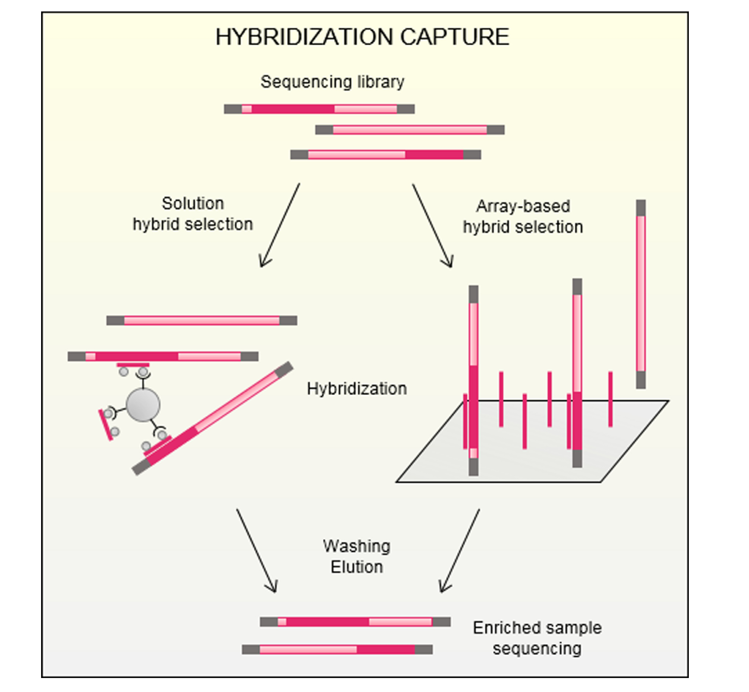
What is targeted capture?
All targeted capture involves first making a shotgun gDNA library
Reduced representation comes from hybridization to targeted probes
Does NOT rely on enzymatic treatment
The number of probes is known and can be fully customized
Gasc et al. 2016
BIO 594

Slide 7
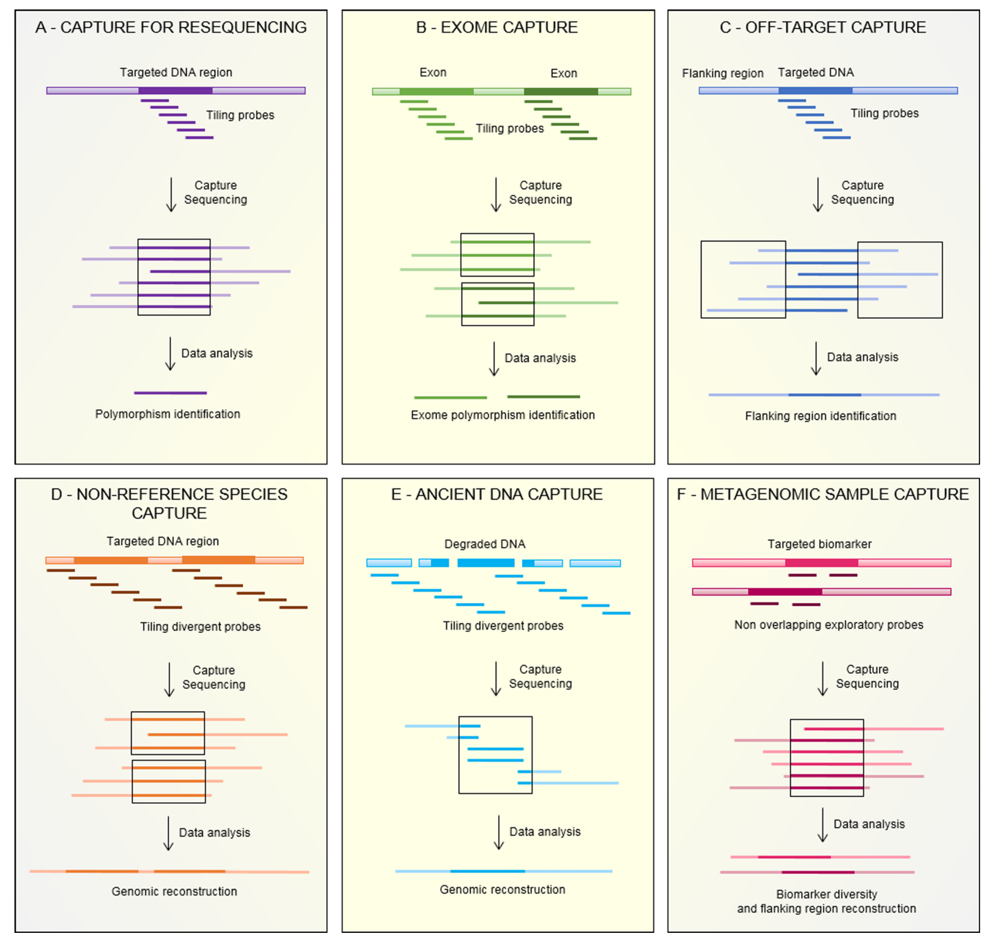
What is targeted capture?
Customization allows for a variety of applications
Dependent on research question
Involves both the number of targets and the number of probes per target
Gasc et al. 2016
BIO 594

Slide 8
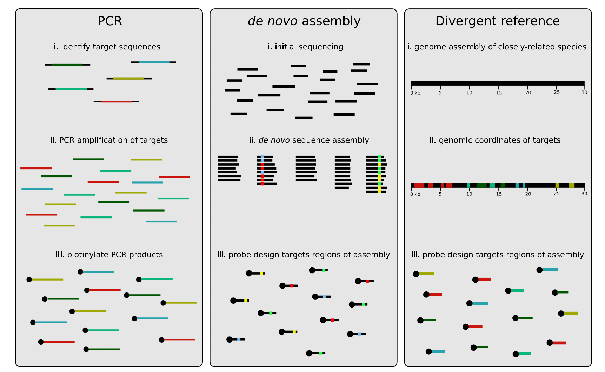
What is targeted capture?
Jones and Good 2016
BIO 594

Slide 9
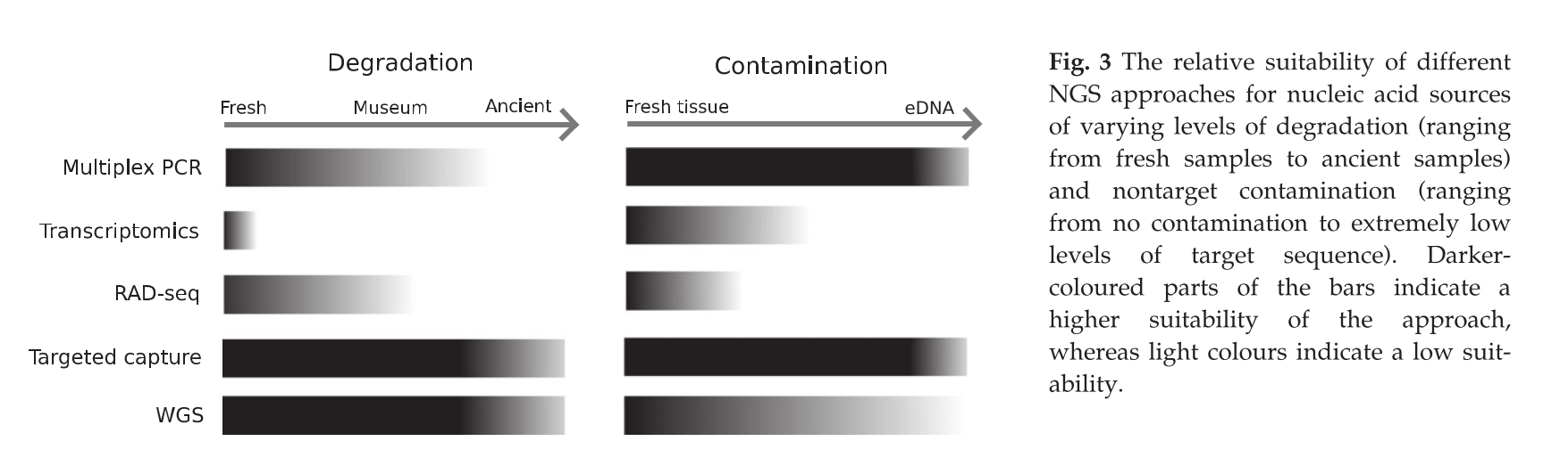
Why use targeted capture?
Jones and Good 2016
BIO 594

Slide 10
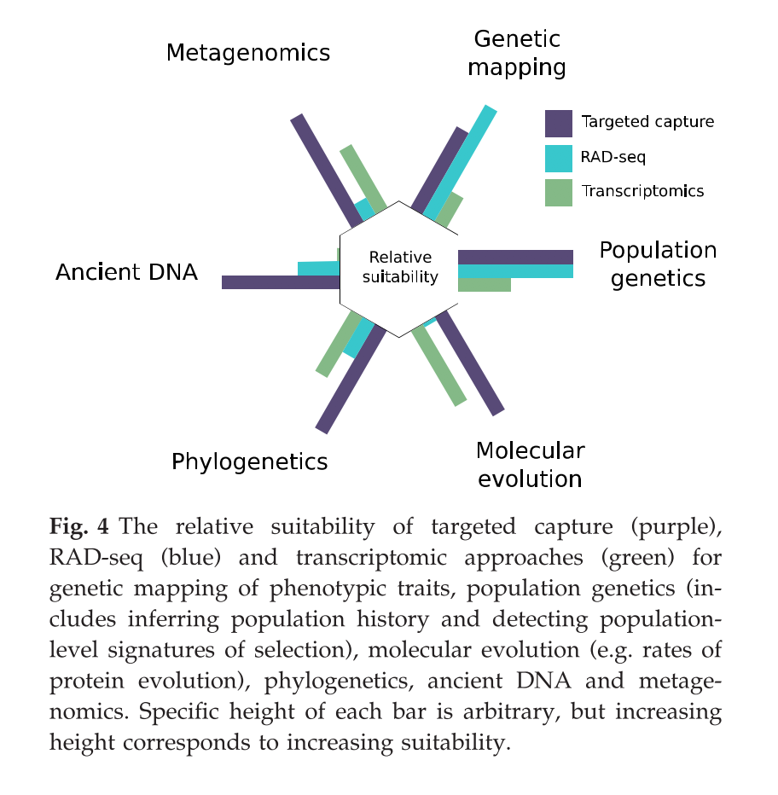
Why use targeted capture?
Jones and Good 2016
BIO 594

Slide 11
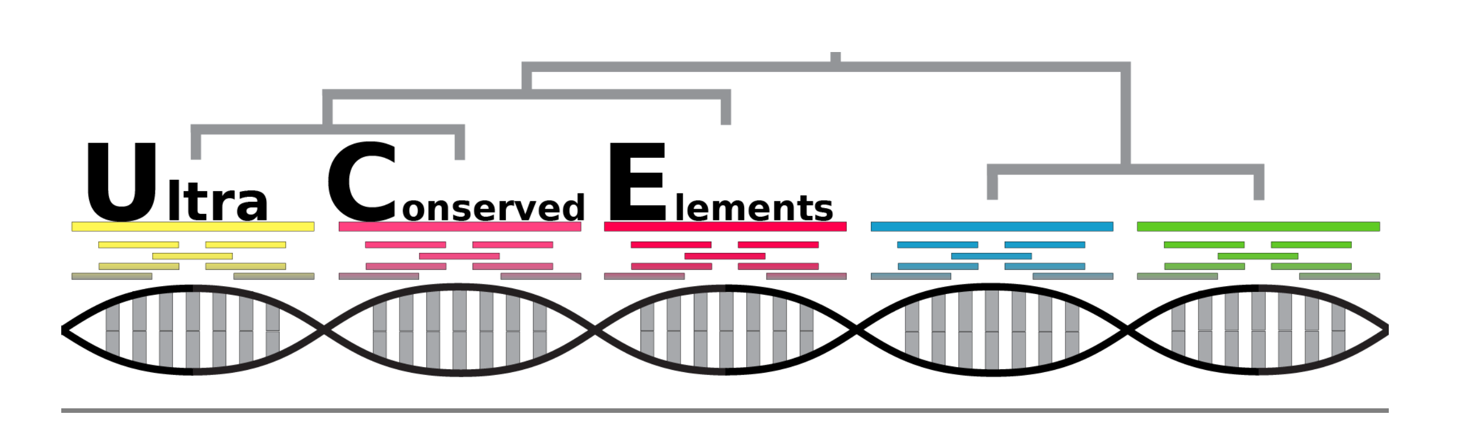
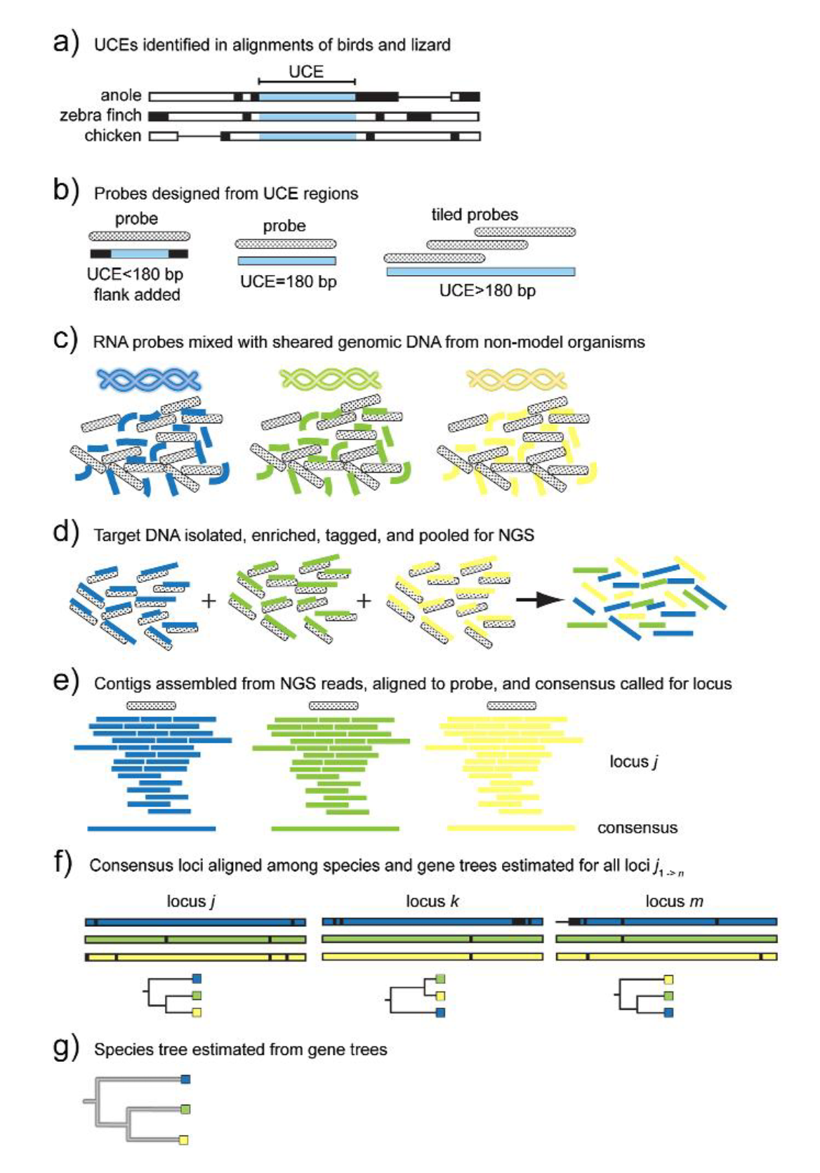
Ultra Conserved Elements
UCEs
highly conserved regions of organismal genomes shared among evolutionary distant taxa
Uses-
data from UCEs and the DNA adjacent to UCE locations (flanking DNA), and that these data are useful for reconstructing the evolutionary history and population-level relationships of many organisms
http://ultraconserved.org
Faircloth et al. 2012
BIO 594

Slide 12
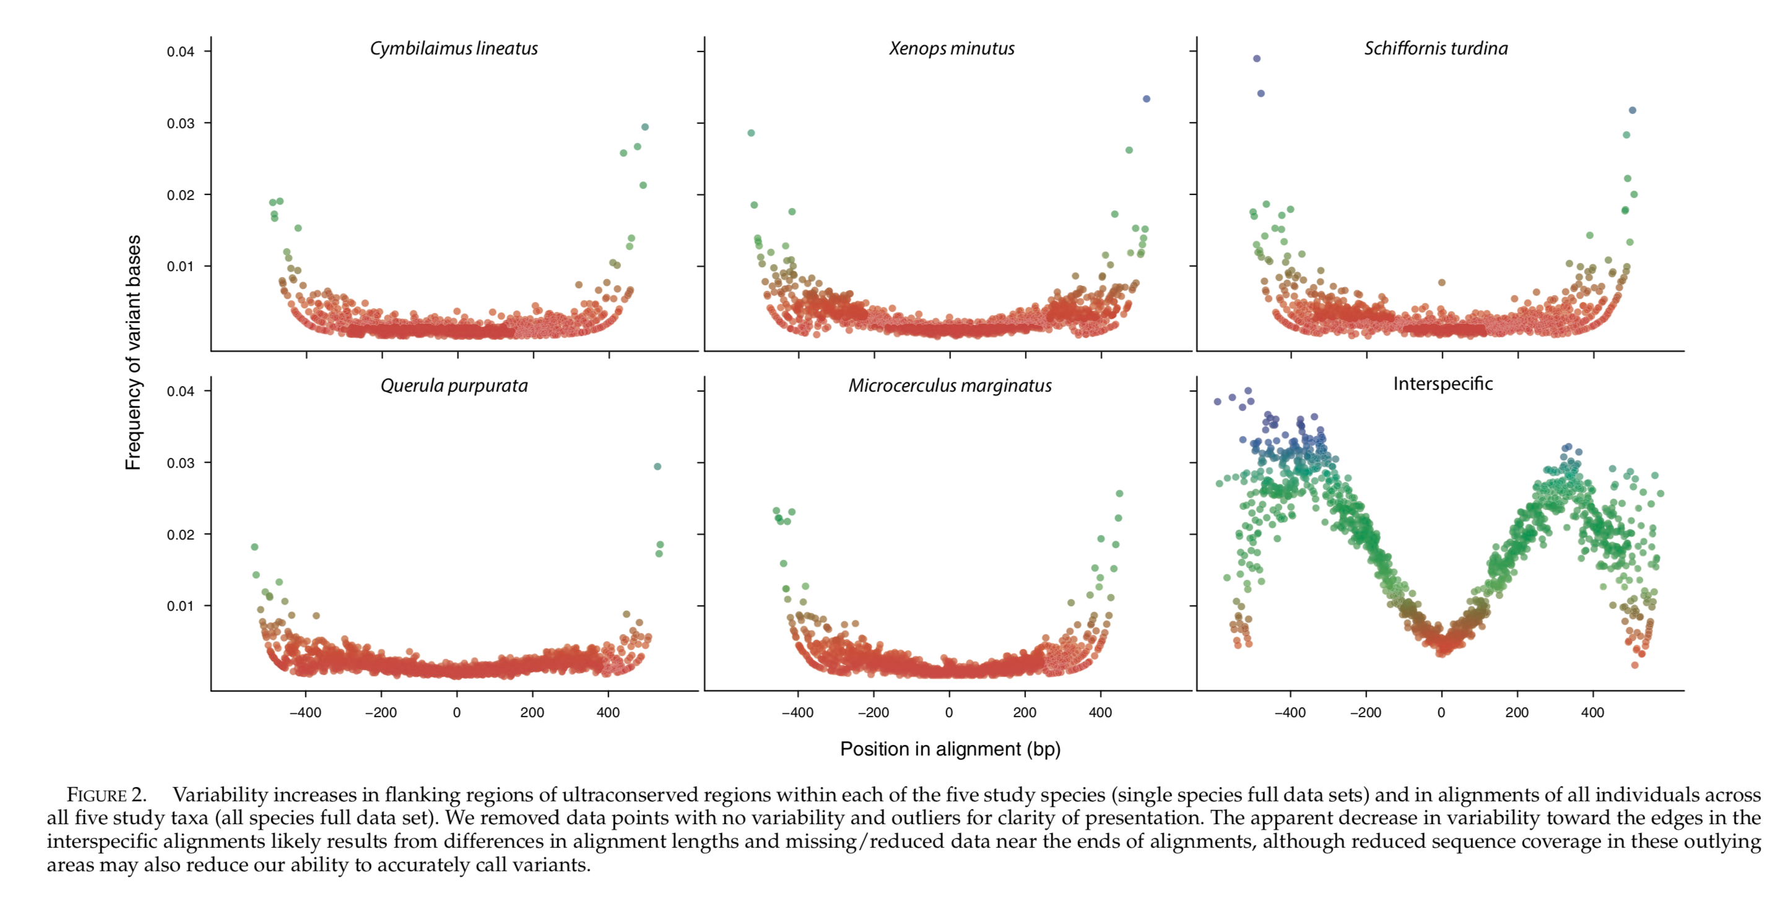
Ultra Conserved Elements
Smith et al. 2014
BIO 594

Slide 13
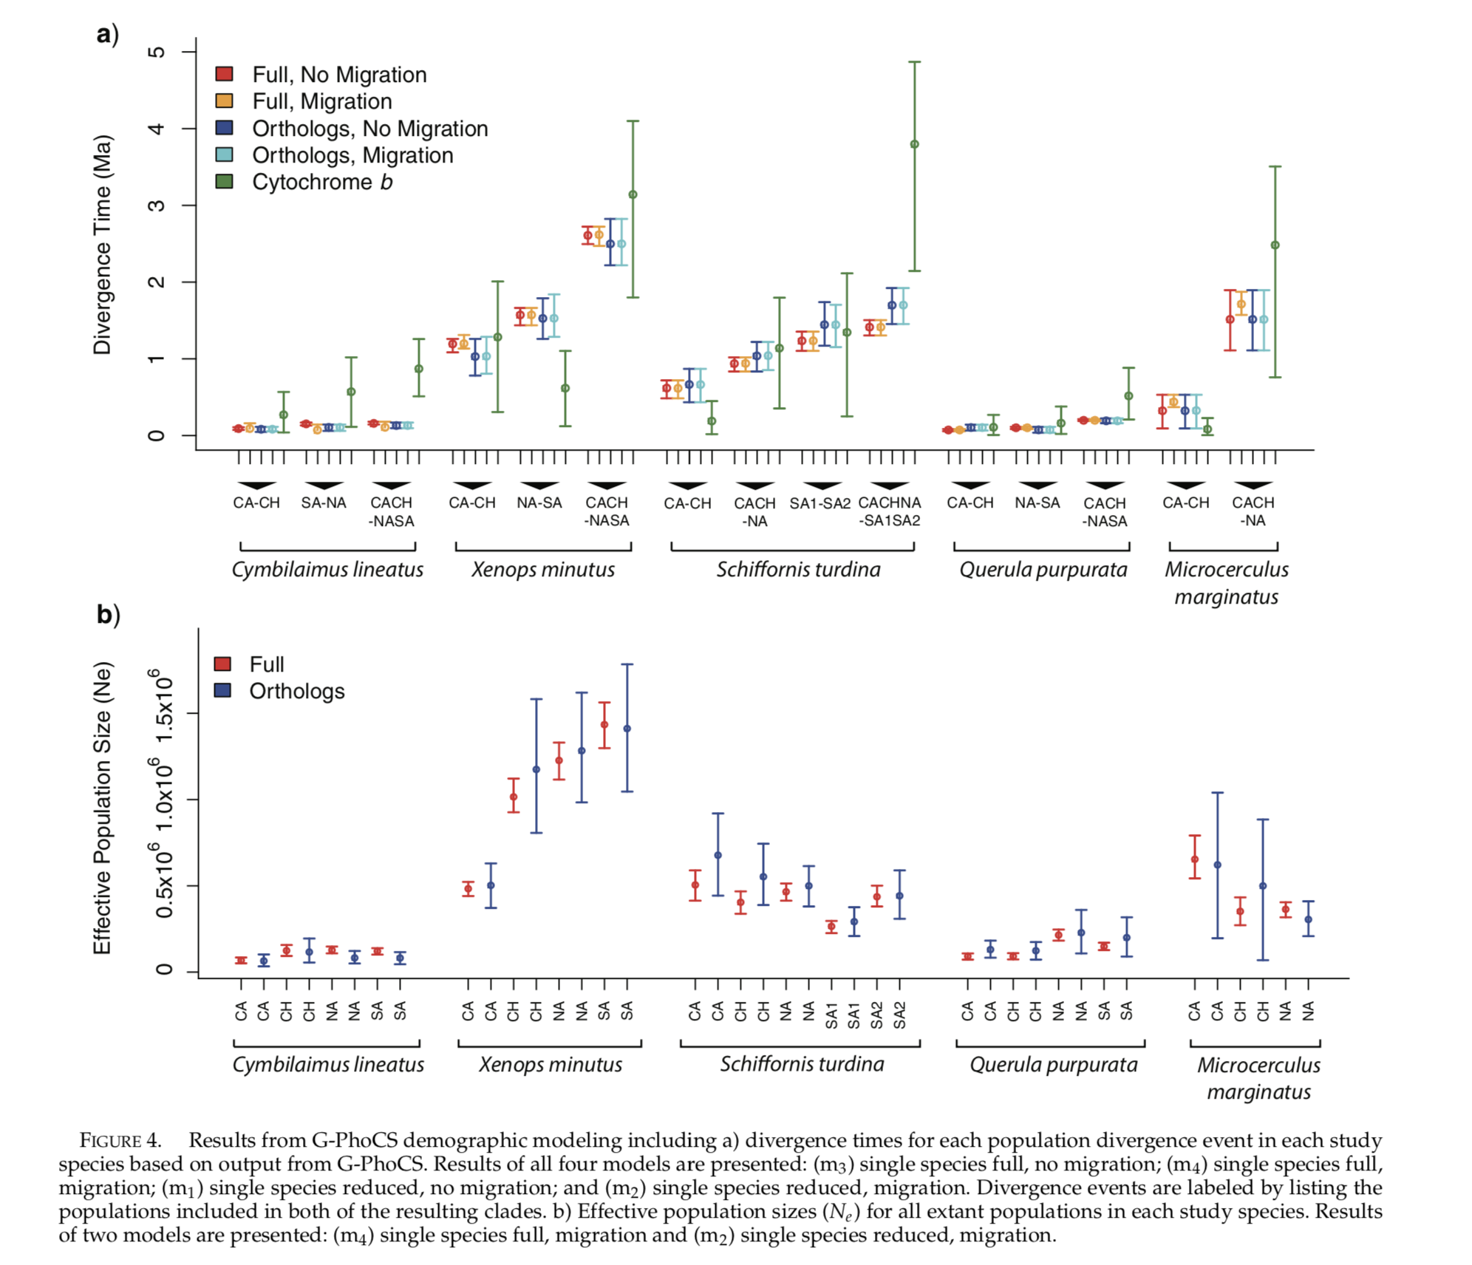
Ultra Conserved Elements
Smith et al. 2014
BIO 594

Slide 14
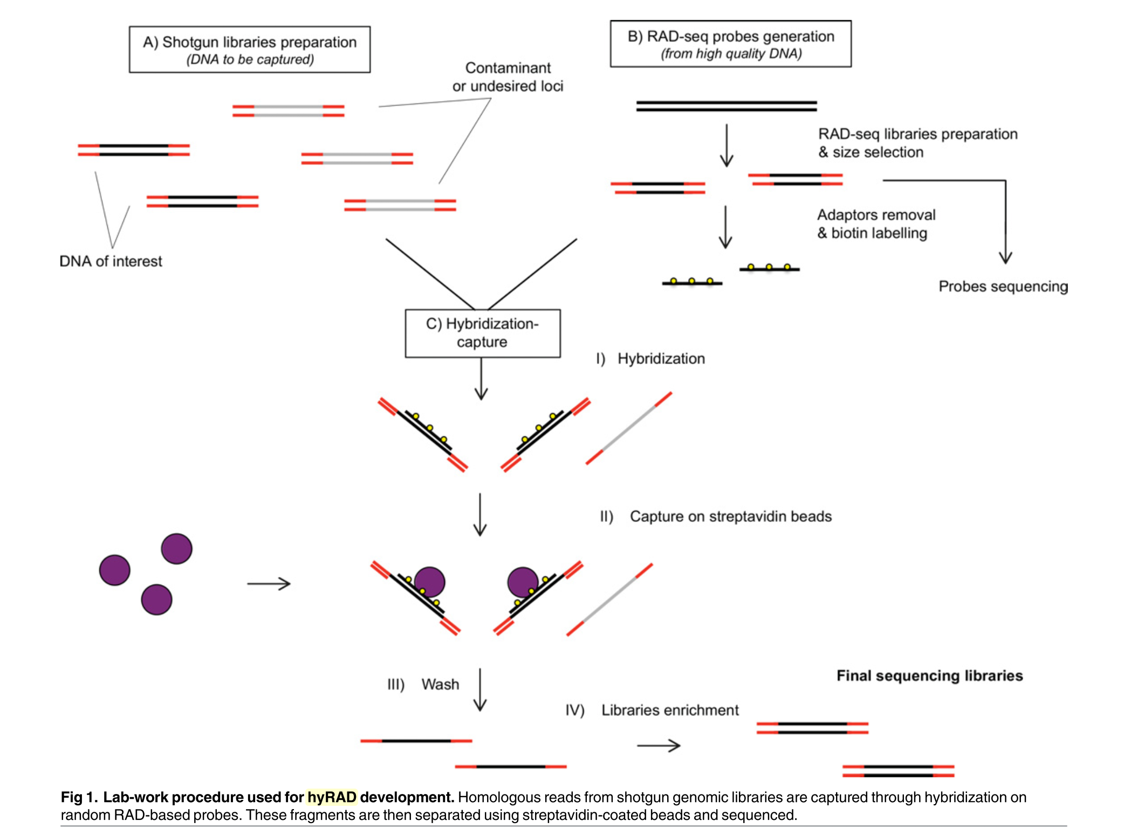
RAD capture, Rapture, hyRAD, hyRAD-X
Suchan et al. 2016
BIO 594

Slide 15
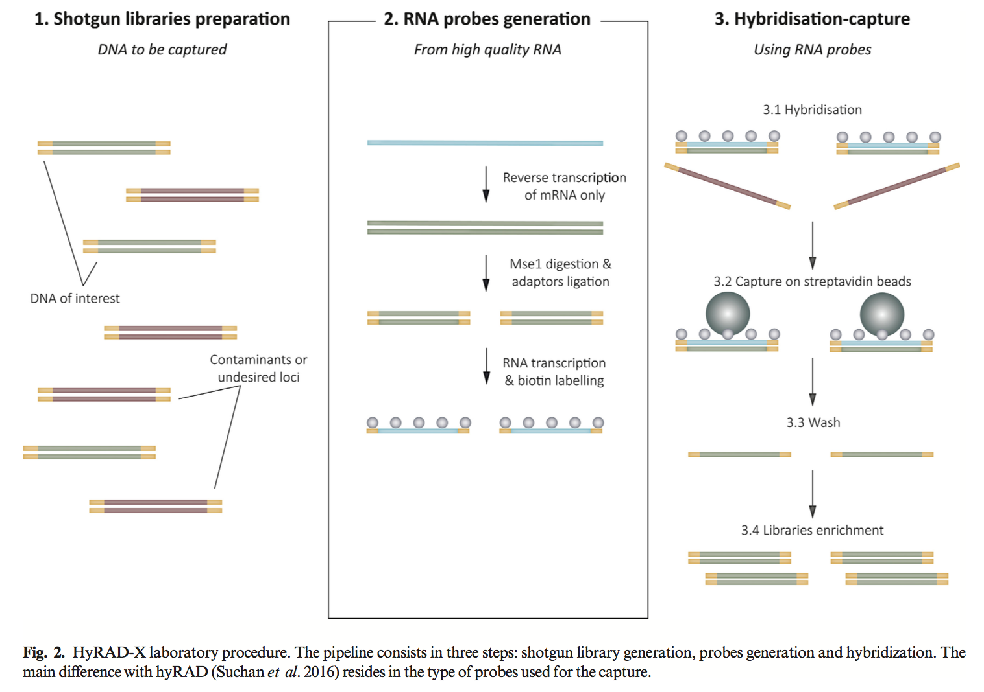
RAD capture, Rapture, hyRAD, hyRAD-X
Schmid et al. 2017
BIO 594

Slide 16
Exome capture
BIO 594

Slide 17
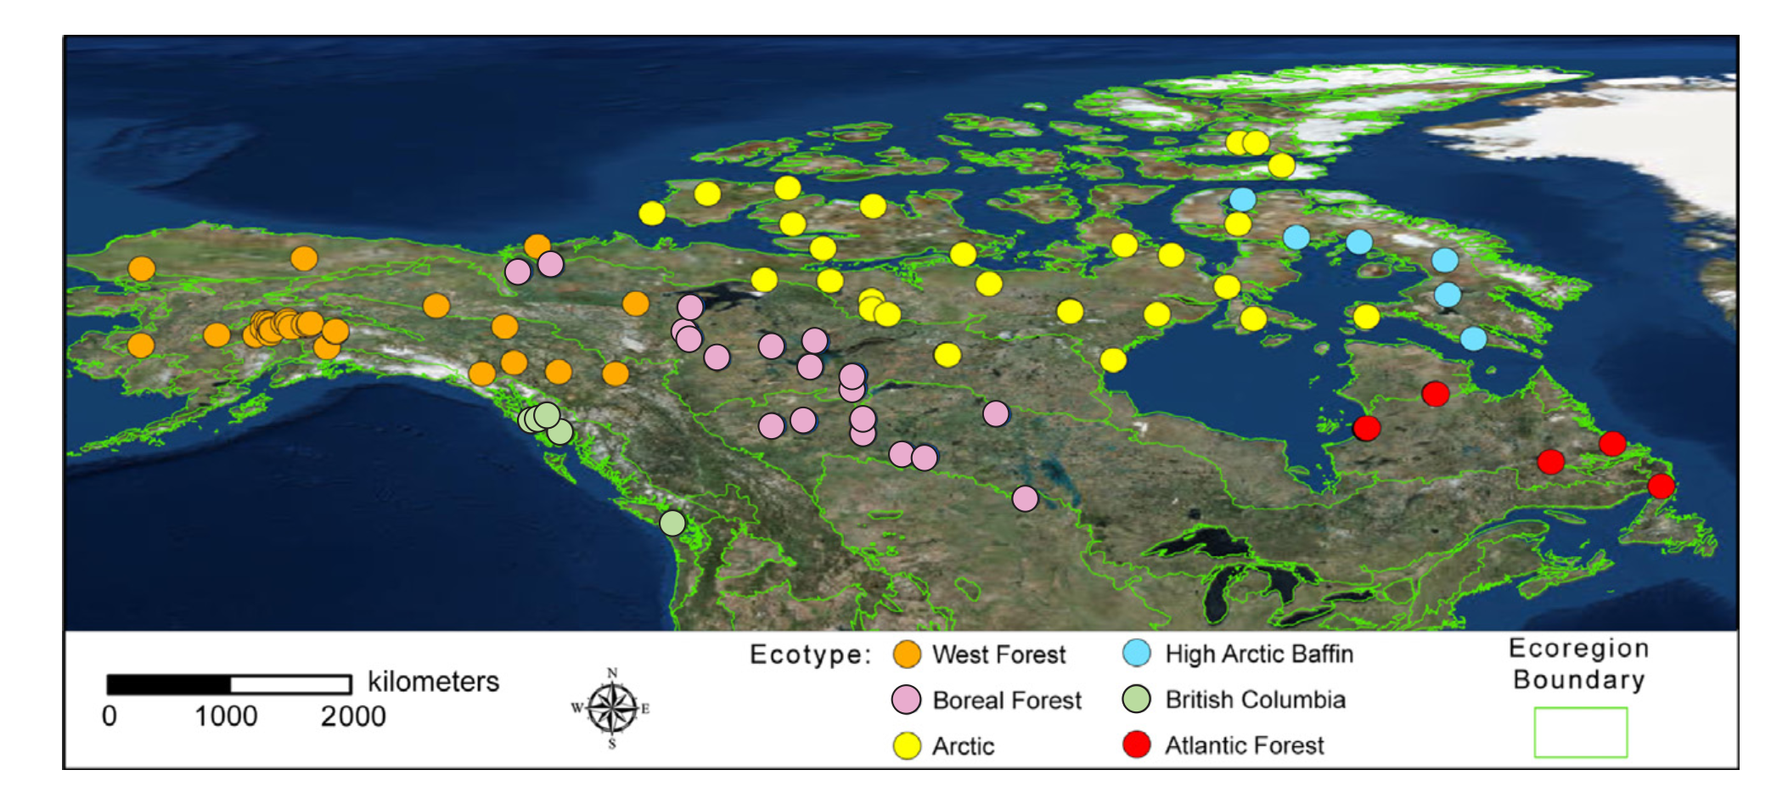
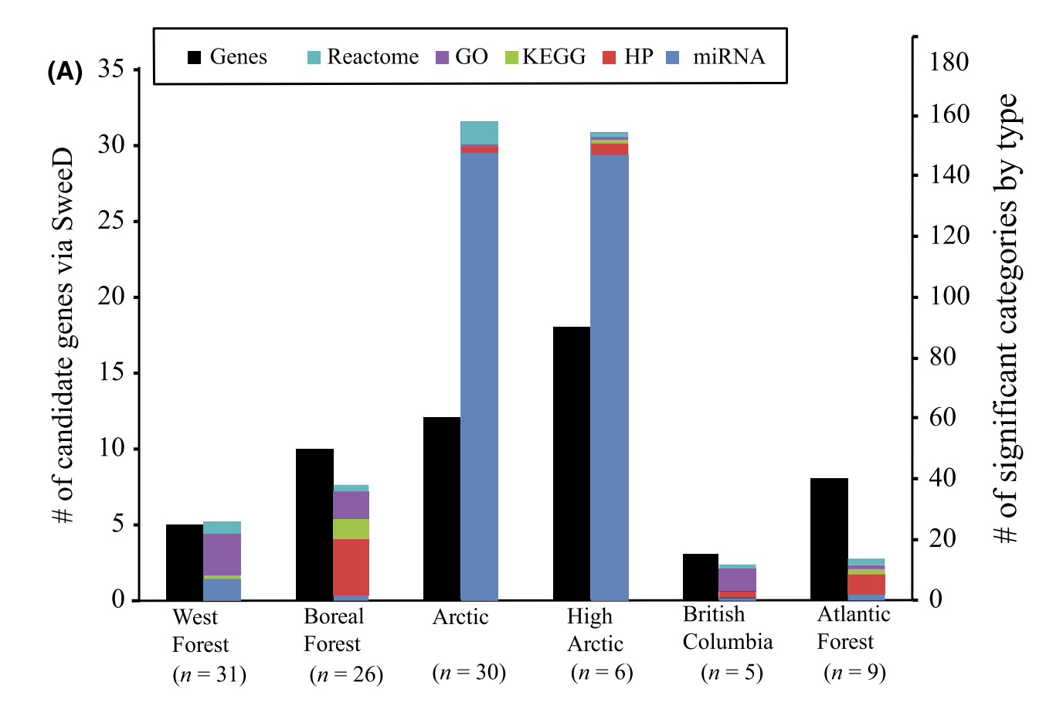
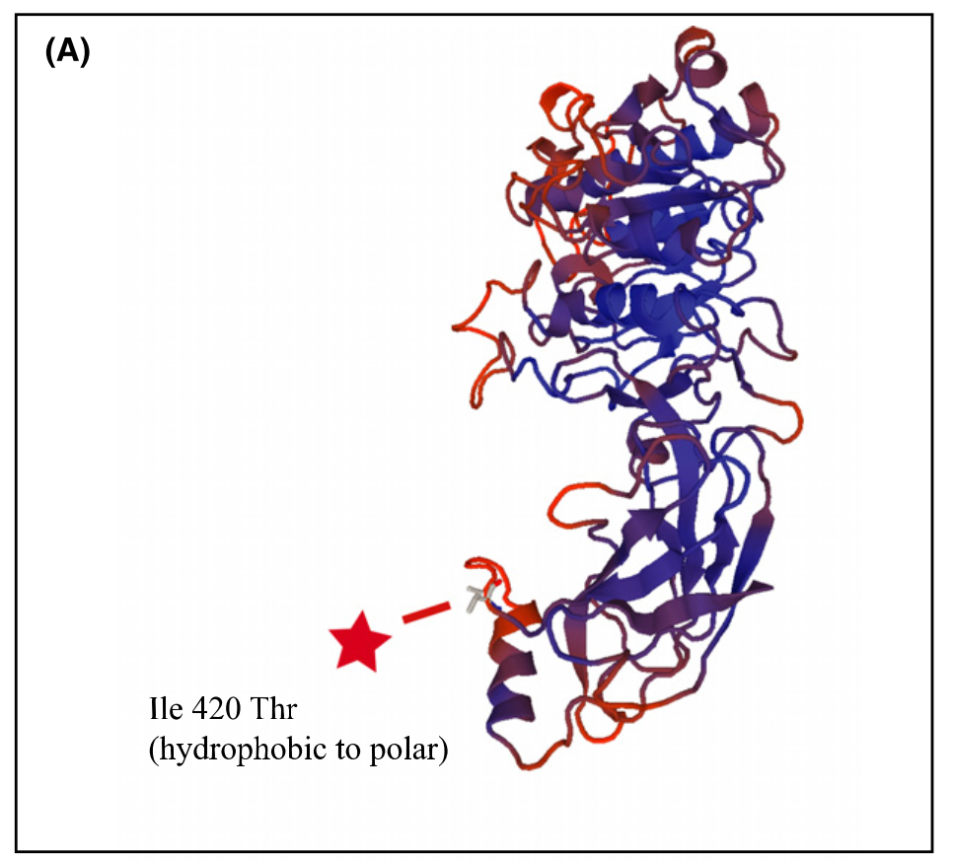
Exome capture
Schweizer et al. 2016
BIO 594

Slide 18

Traditional exome capture
Probes
Hybridize to DNA library
Capture
Wash, elute, PCR enrich
Sequence

Slide 19
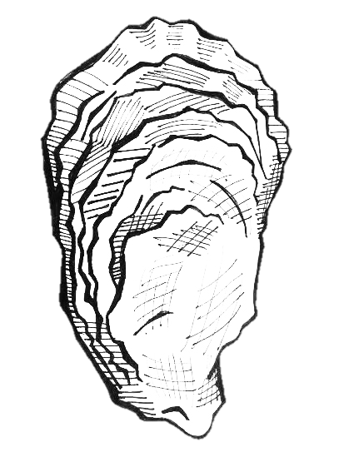
Expressed exome capture sequencing
Probes
Hybridize to DNA library
Capture
Wash, elute, PCR enrich
Sequence

Slide 20
EecSeq
Use expressed mRNA to probe the exome
Remove the need for a previously sequenced transcriptome
Remove the cost and time associated with probe synthesis
EecSeq!

Slide 21
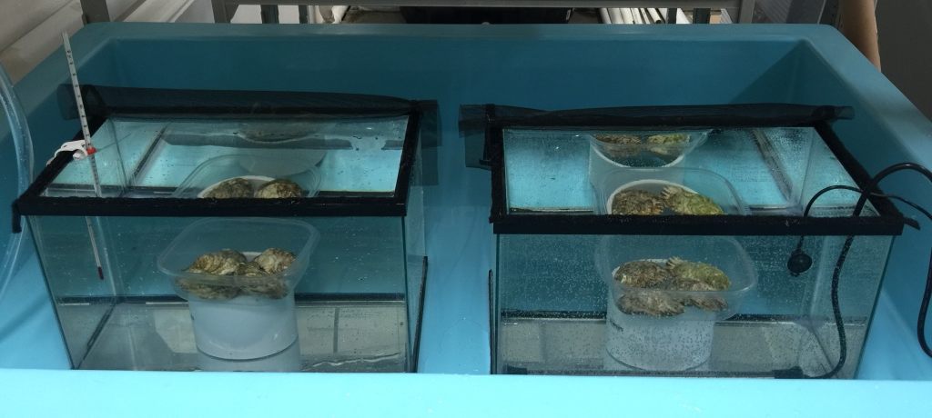
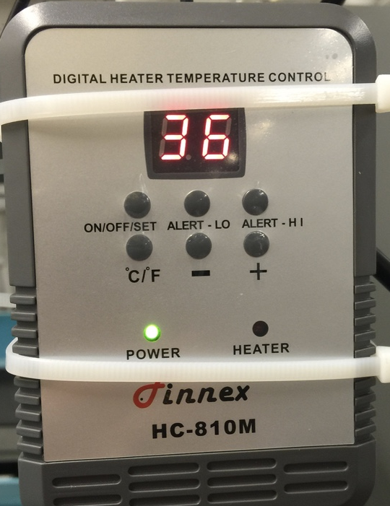
EecSeq: Proof of Concept
Simple heat shock exposure
4 exposed individuals at 36 ºC for 1 hour
4 control individuals at ambient (12 ºC for 1 hour)

Slide 22

Control oysters
DNA extraction
RNA extraction
Exposed
oysters
Shotgun library preparation
mRNA library preparation
Exon loci
Custom Adapters
Hybridization
Genomic Library
Non-target loci does not hybridize
Adapter removal and biotin labeling
DSN Normalization
Non-target loci
Probe
Probes
Saved for transcriptome sequencing
Exome capture
Biotin
Streptavidin bead
Exon loci
Wash and elution
PCR
Enrichment
Exome sequencing

Slide 23
Sequencing
6 replicate captures of 8 individuals
Original probes
Original probes plus 12 additional rounds of PCR
~48% of reads mapping to exons

Slide 24
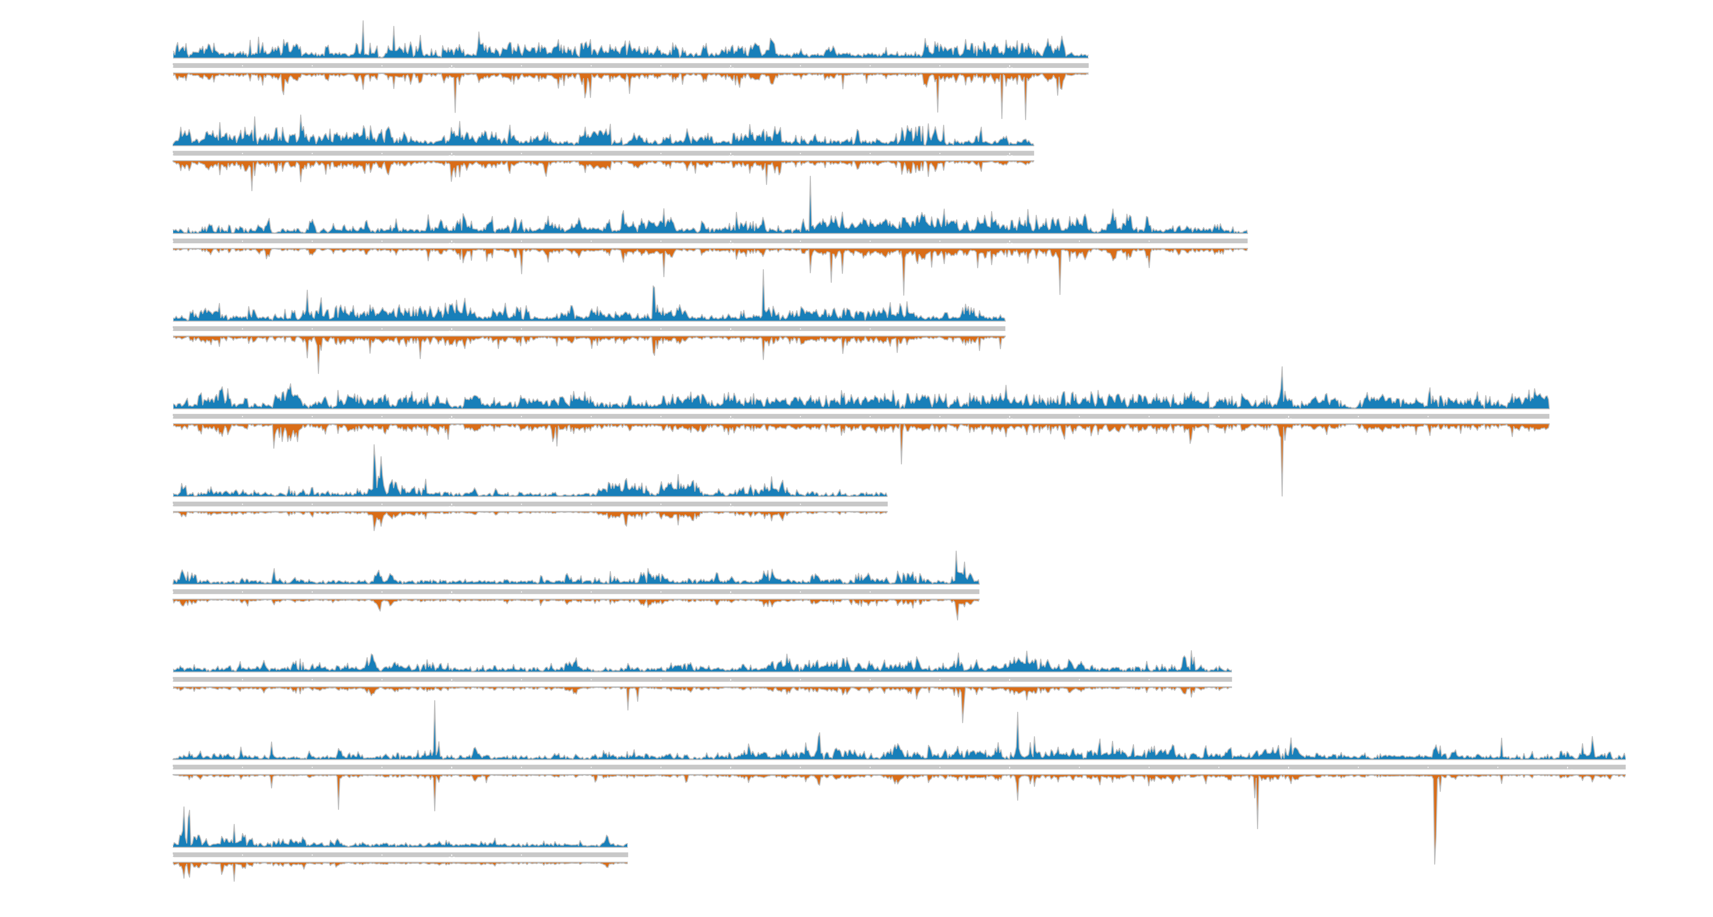
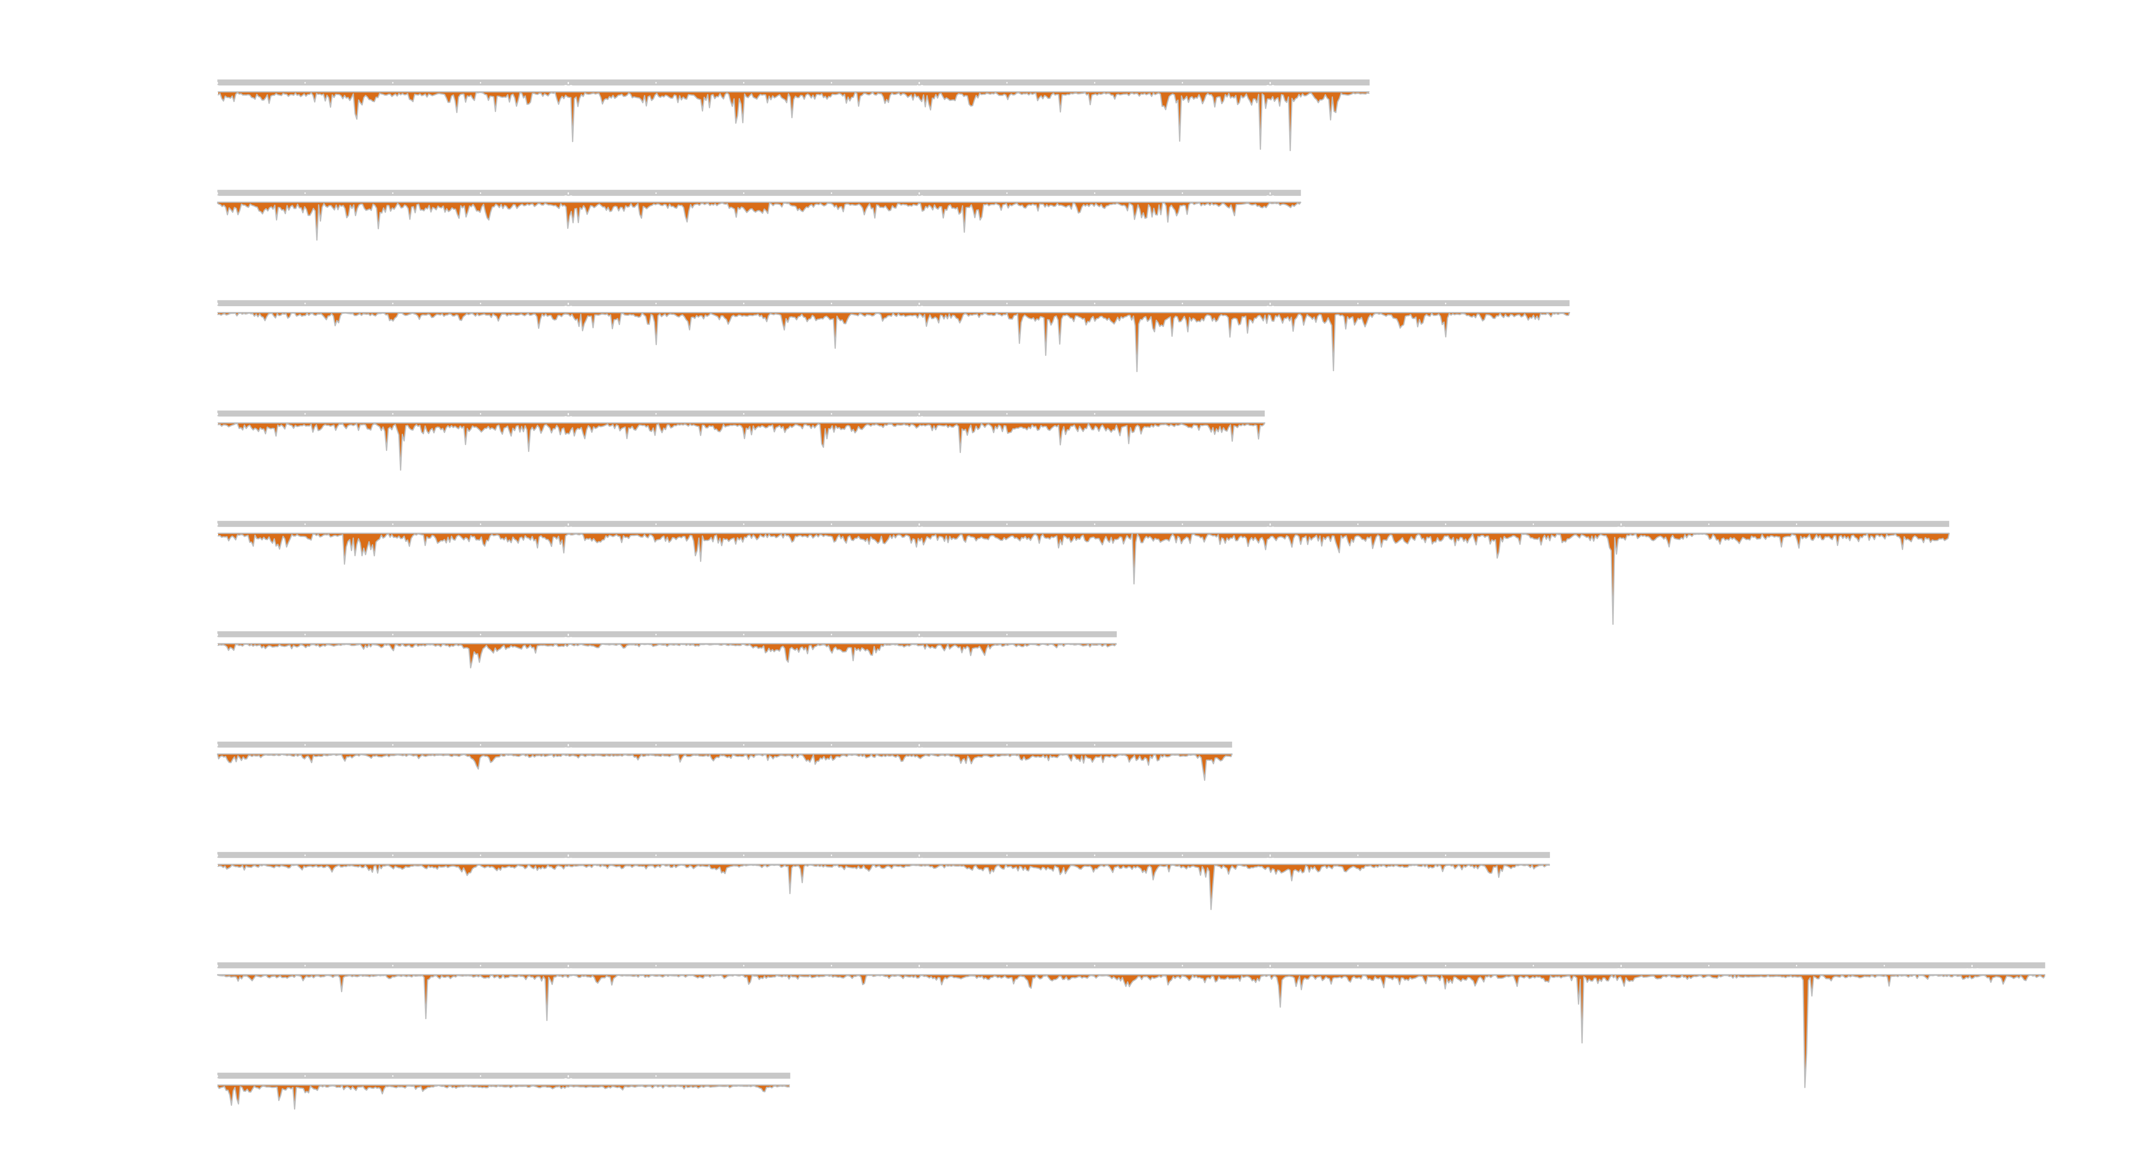

EecSeq targets expressed exons

Slide 25

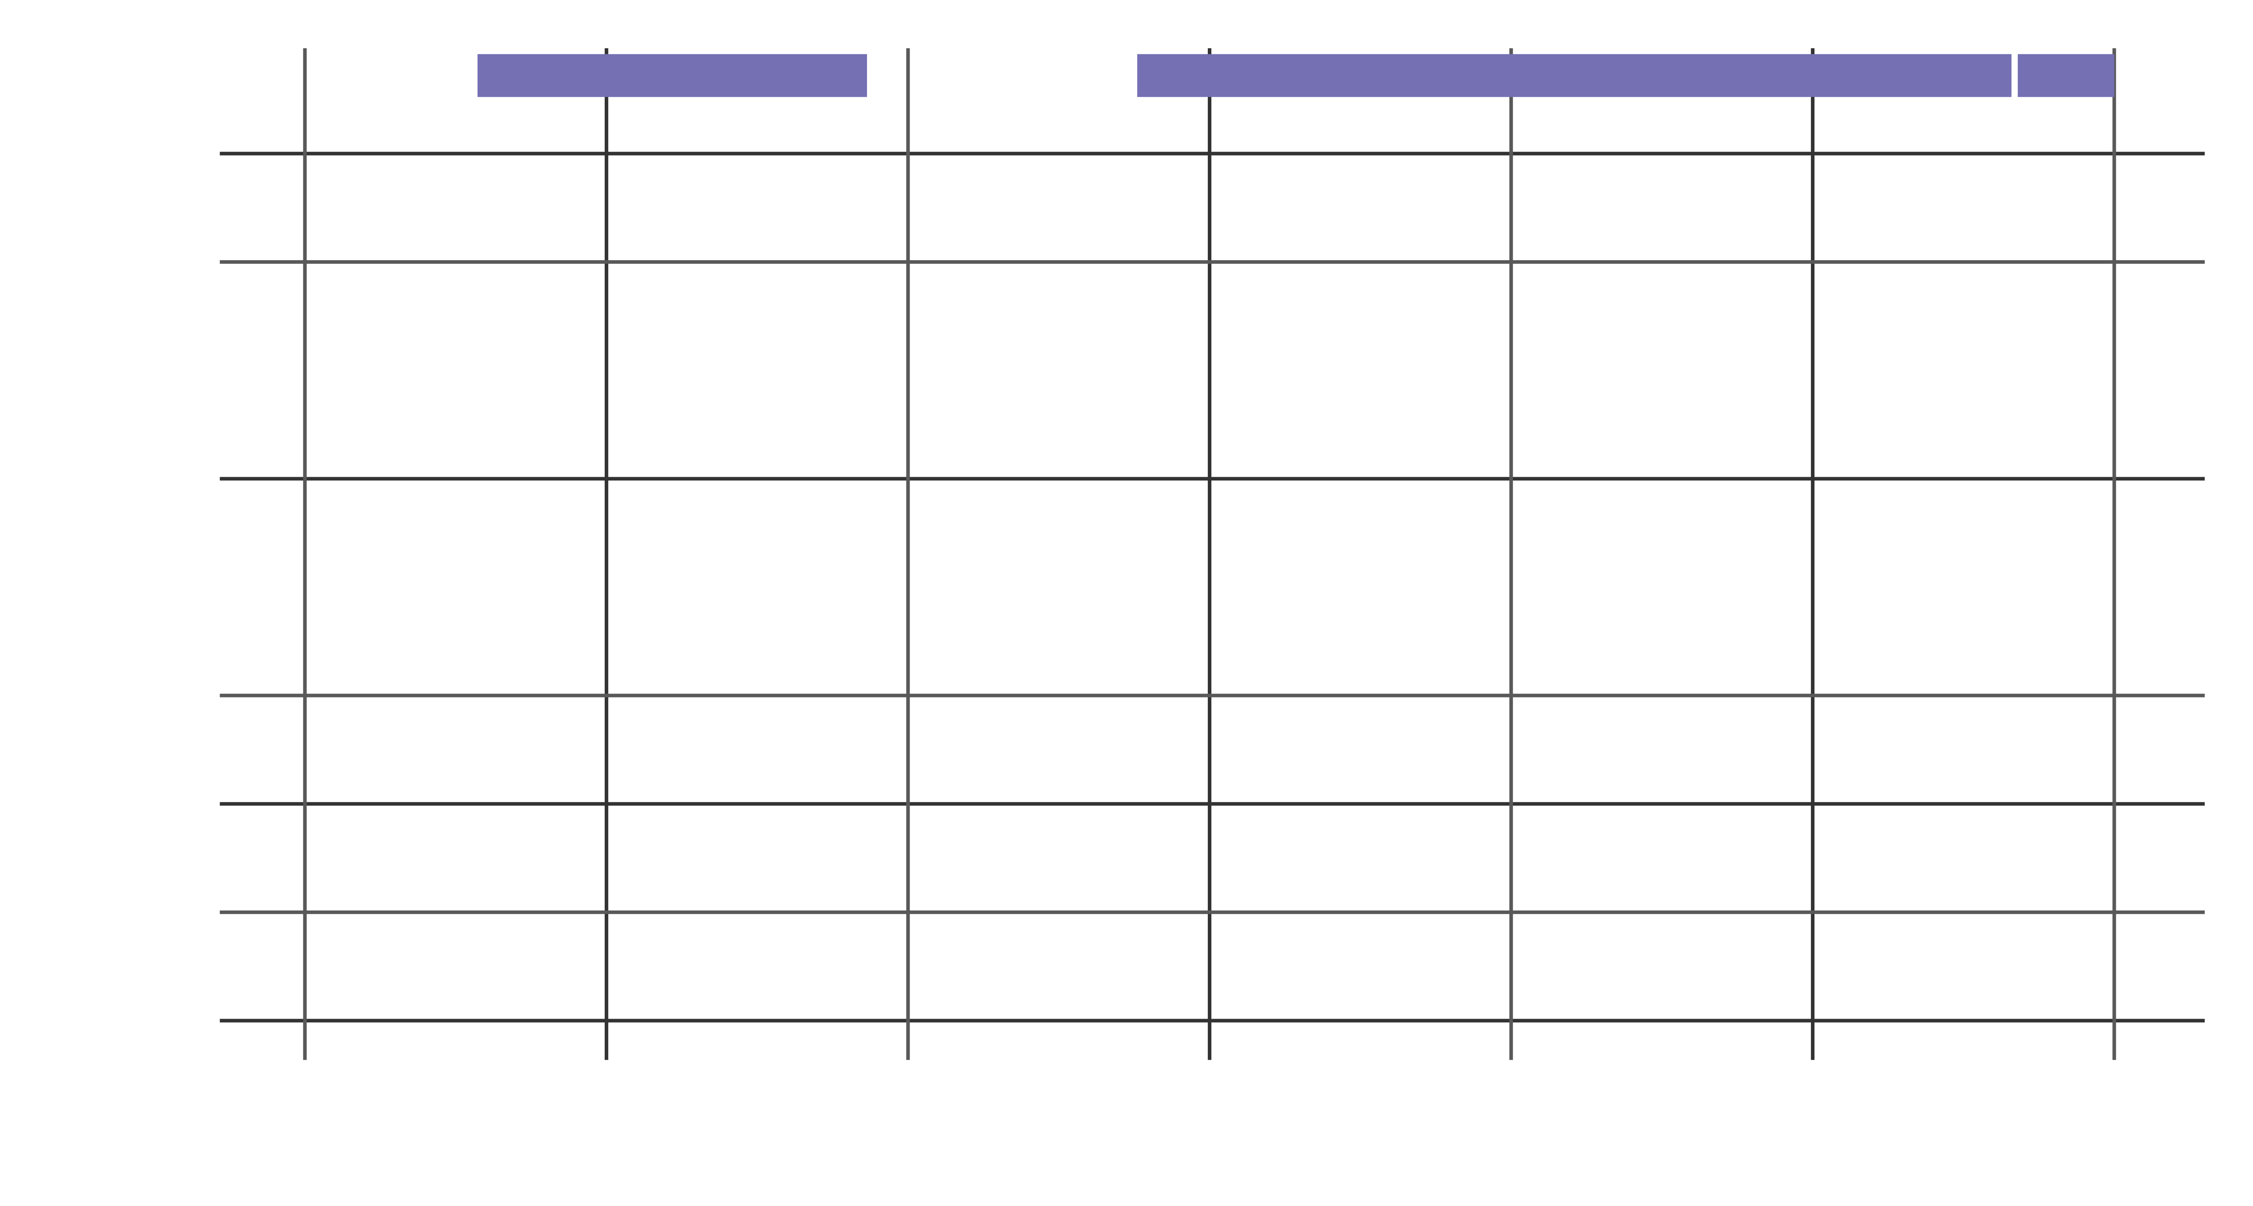
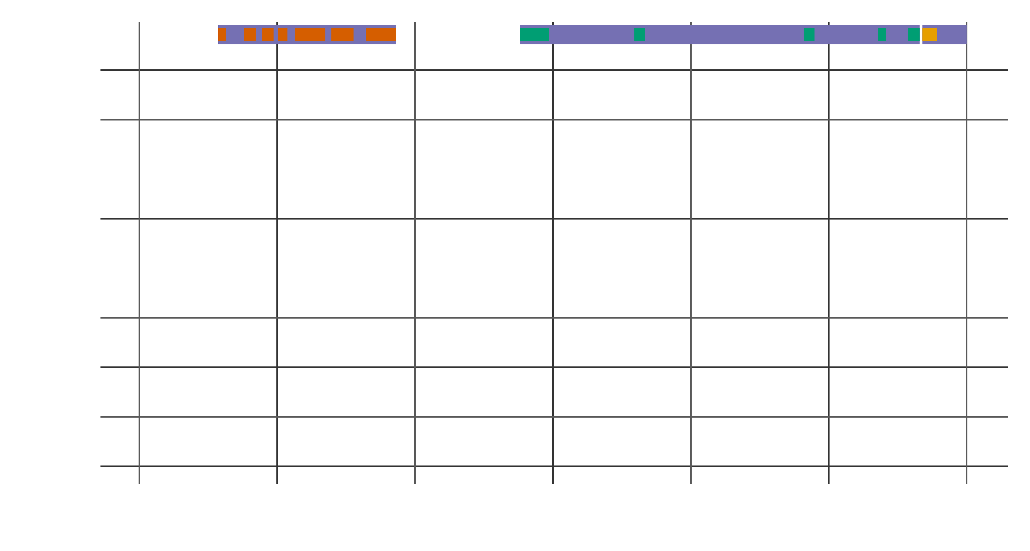
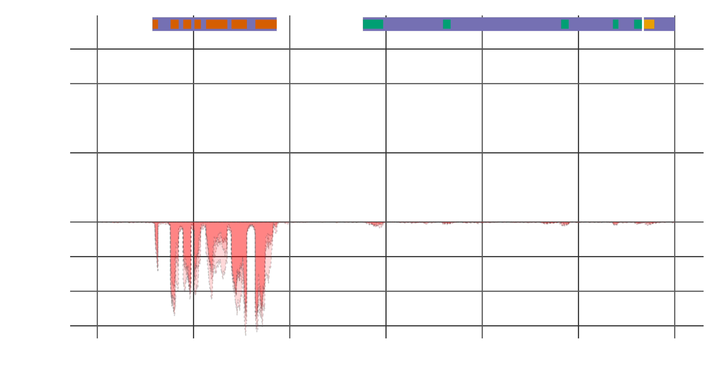

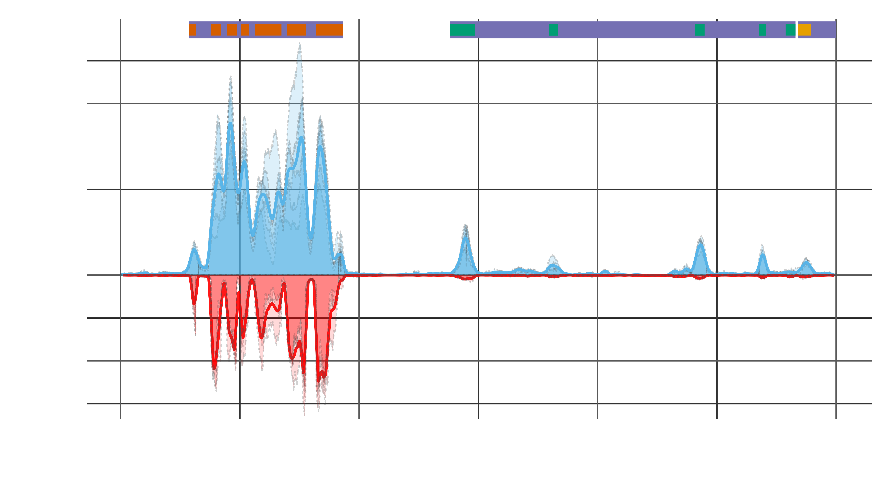
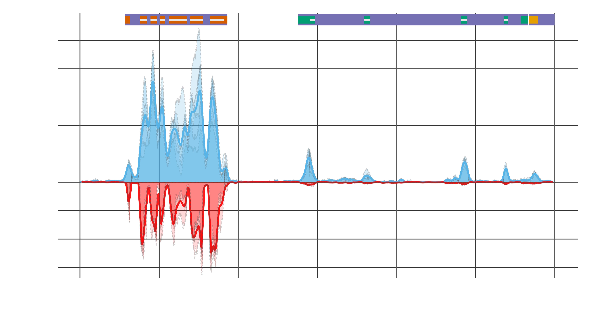
EecSeq targets expressed exons

Slide 26
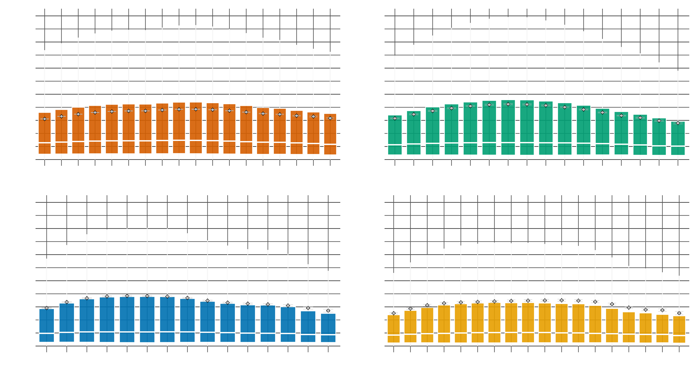
Edge Effects?

Slide 27
Edge Effects?

Slide 28
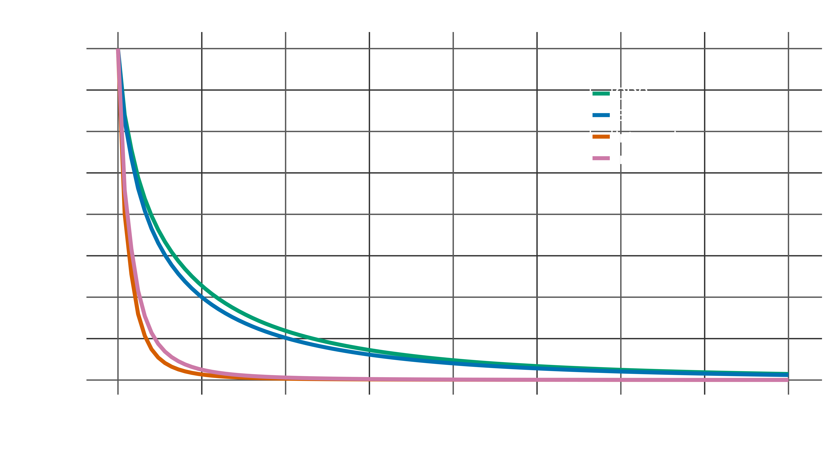
EecSeq Efficiency?

Slide 29
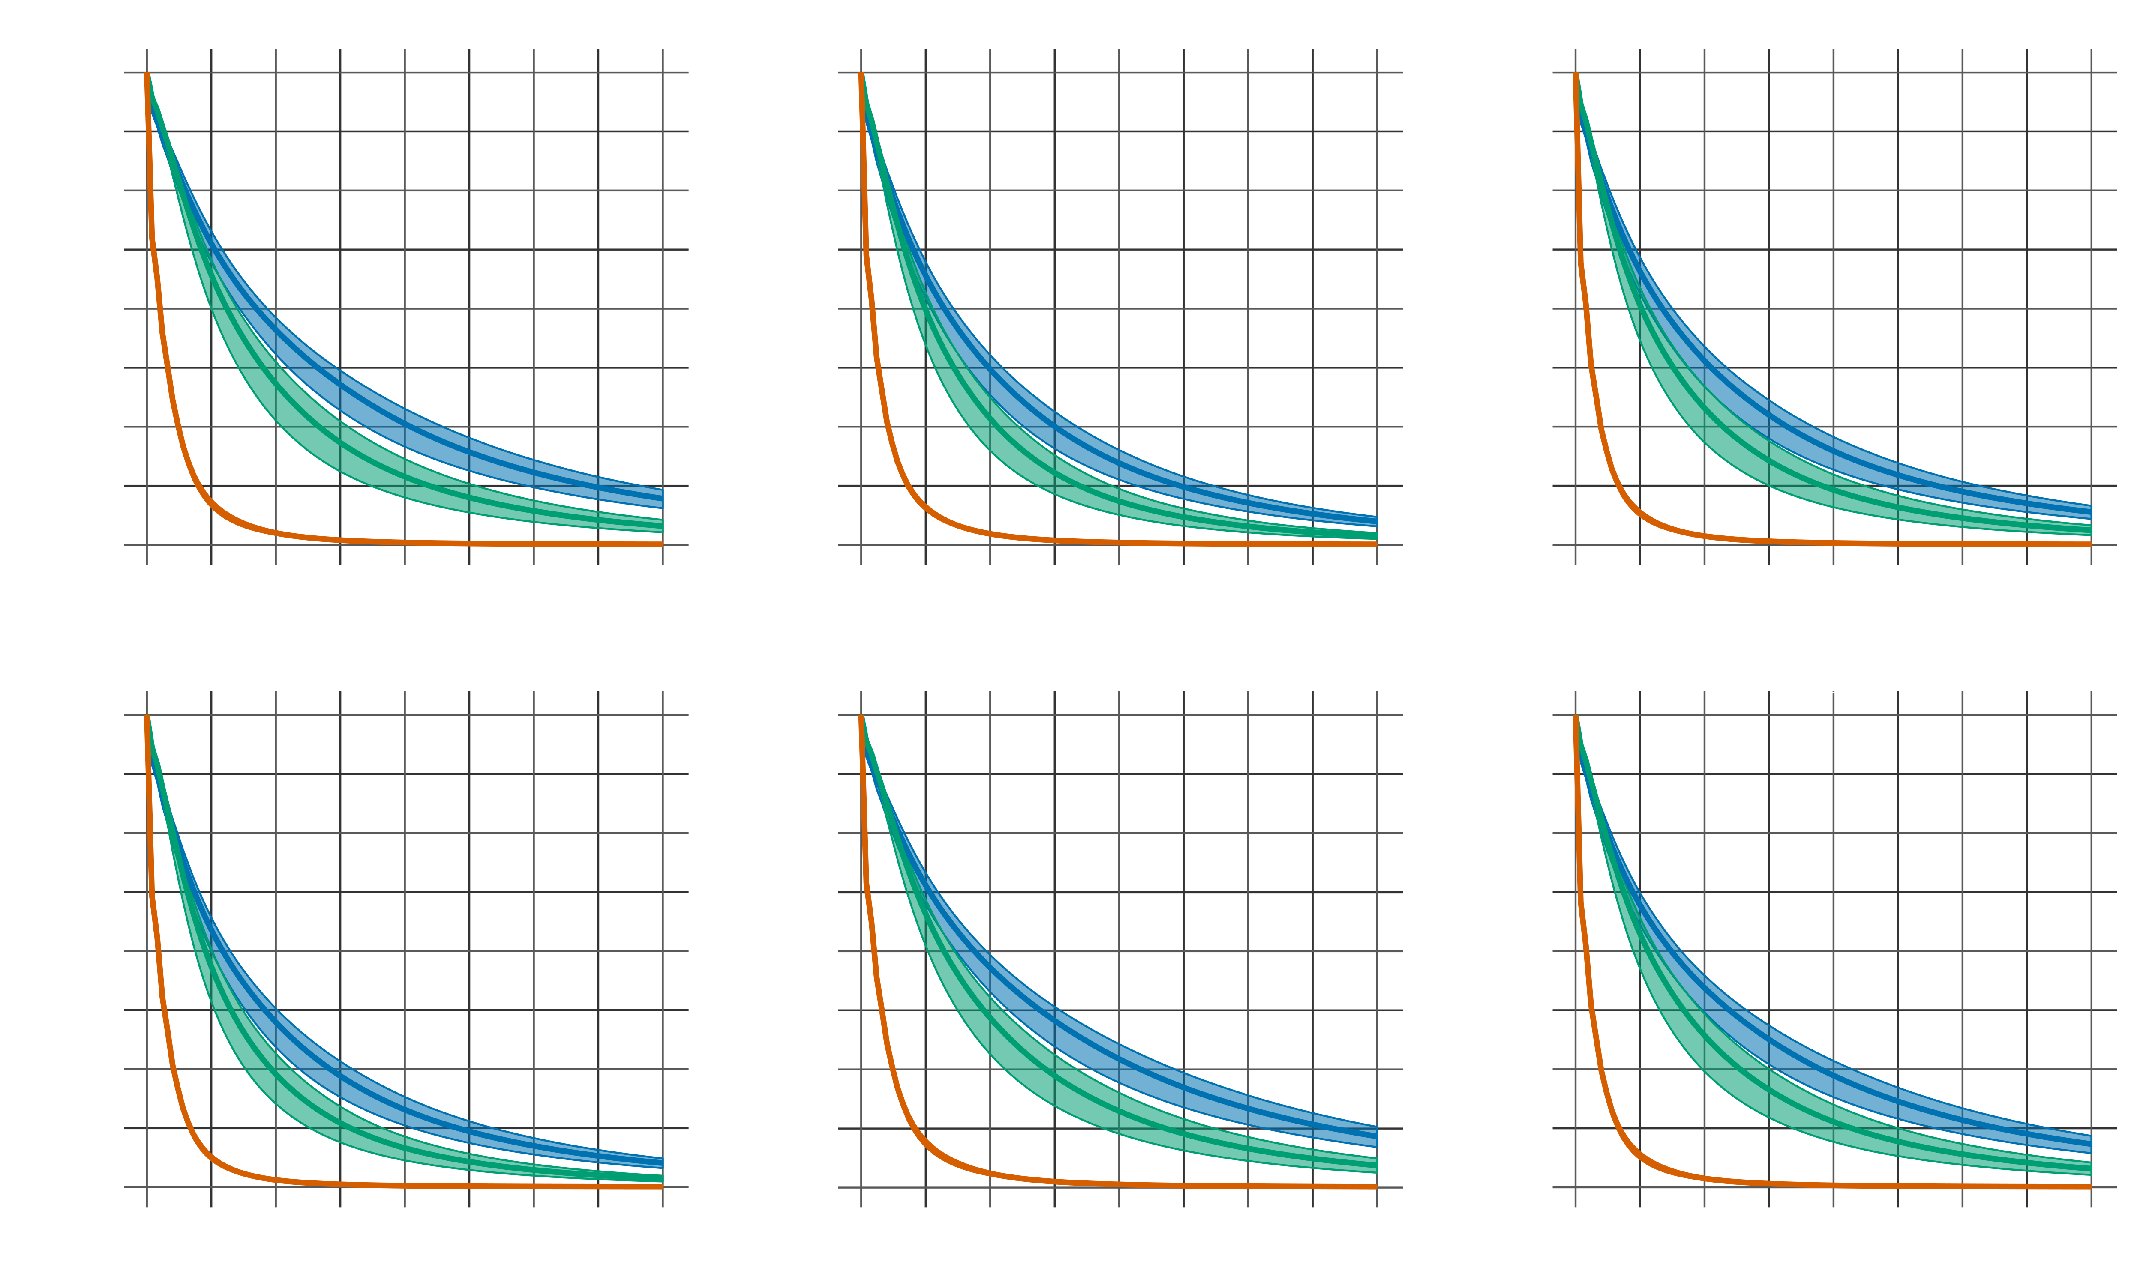
EecSeq capture efficiency

Slide 30
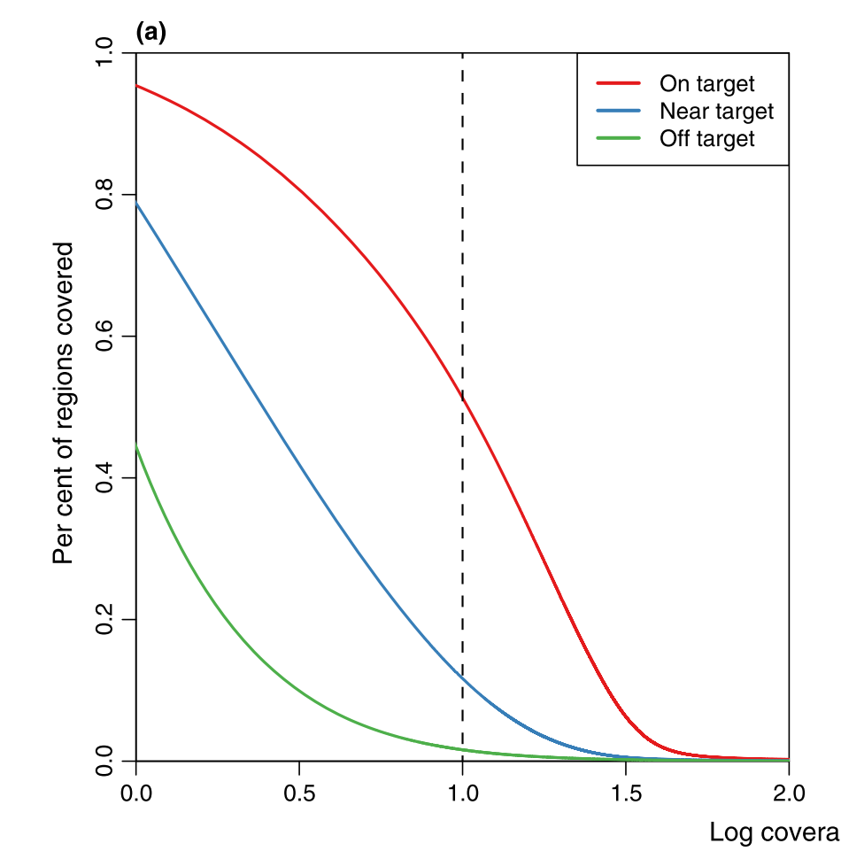
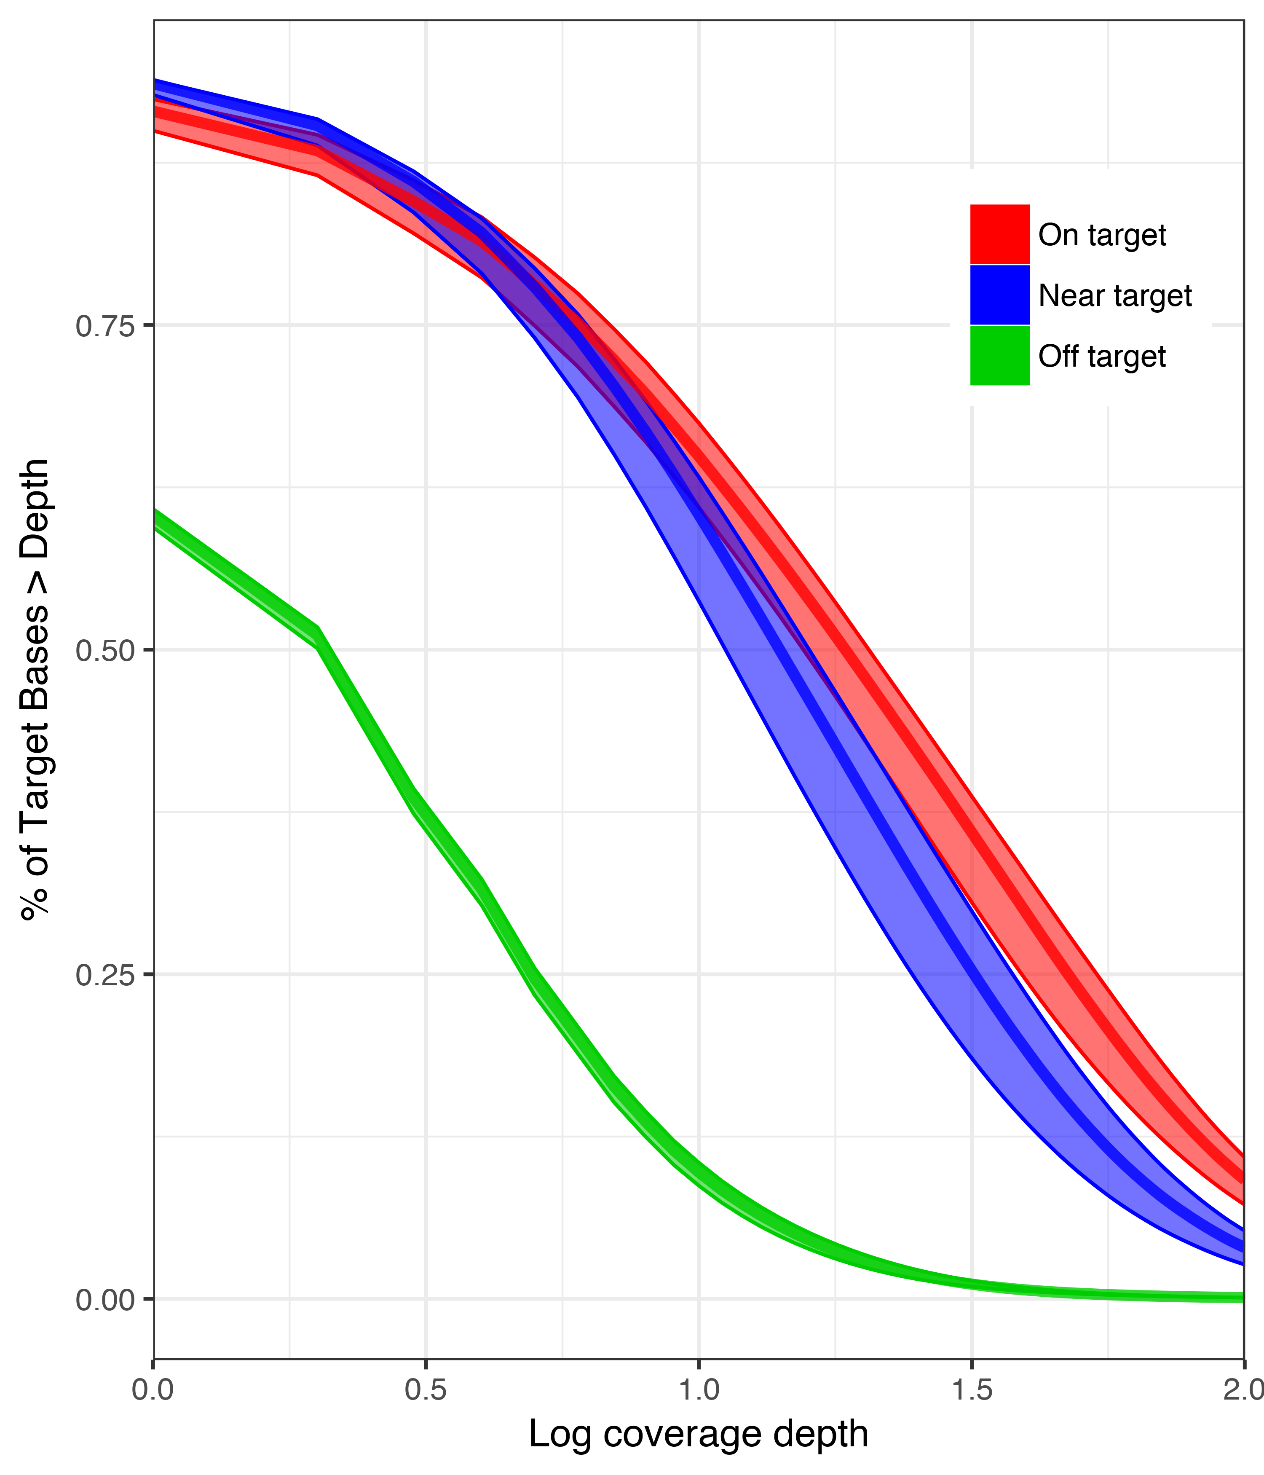
How does EecSeq compare?
Genome/Transcriptome derived
EecSeq
Log coverage depth
Suren et al. 2016

Slide 31
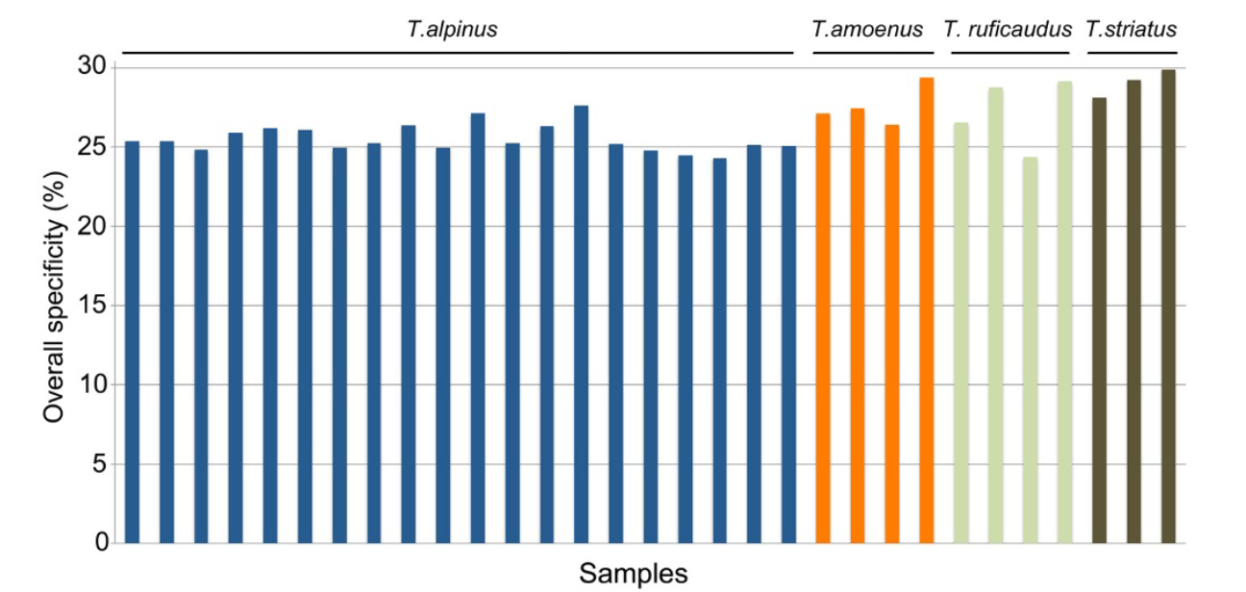
How does EecSeq Compare?
Transcriptome derived
EecSeq
Bi et al. 2012

Slide 32
EecSeq SNPs
Total SNPs | 909,792
Exome SNPs | 99,169
48X Exome SNPs | 8,837
80X Exome SNPs | 3,508

Slide 33
Take home messages
Expressed exome capture sequencing (EecSeq):
Targets expressed exons
Delivers consistent and efficient exome enrichment
Is comparable to traditional methods of exome capture
Generates thousands of exome SNPs cost effectively

Slide 34
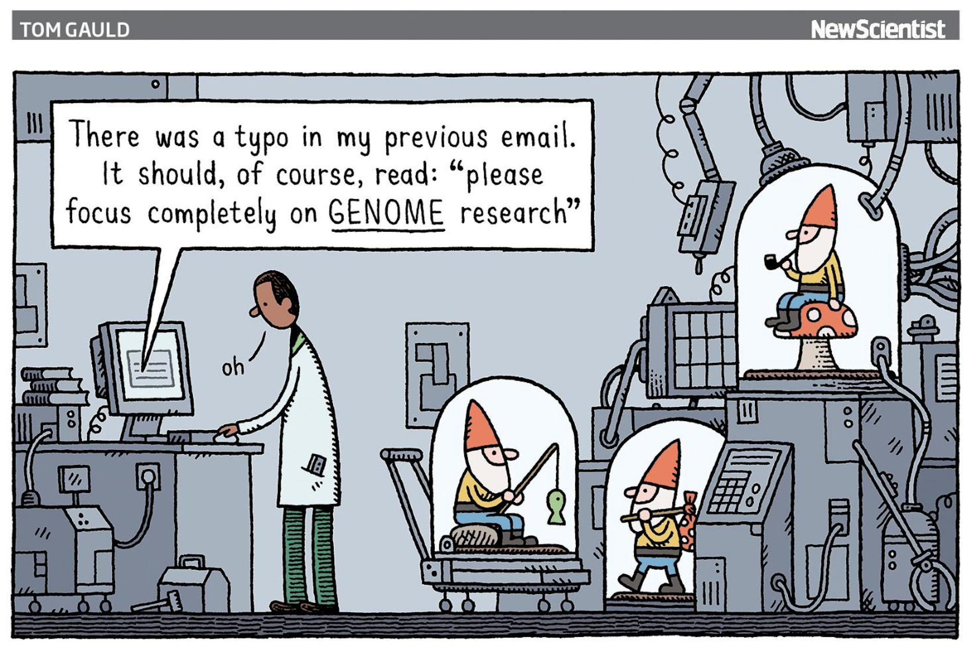
Population genomics without genome reduction
Forget individuals
Estimate allele frequencies from populations directly
PoolSeq
Forget genotypes
Drastically reduce the coverage per individual and work directly with genotype likelihoods
lcWGS
BIO 594

Slide 35
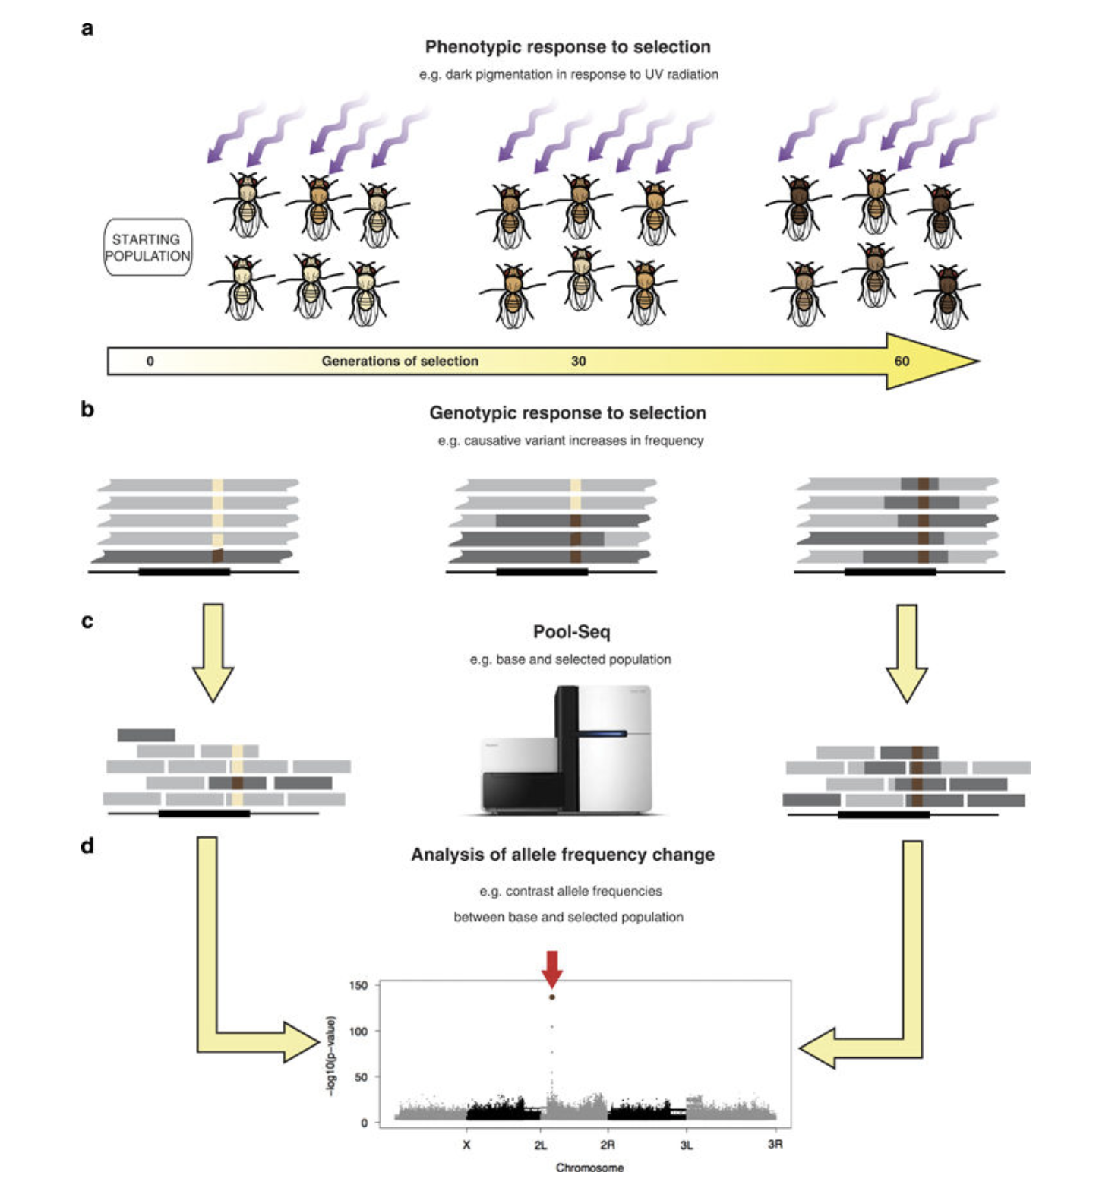
Pooled Sequencing
PoolSeq
DNA/RNA are equimollarly pooled within a population/treatment
Read counts are directly used or placed into a model to estimate the allele frequency of the pool
BIO 594

Slide 36
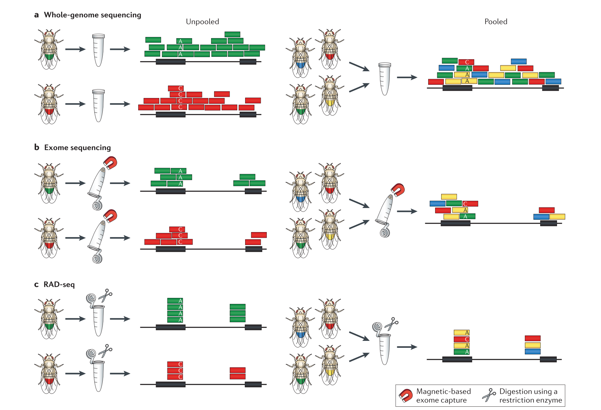
PoolSeq
BIO 594

Slide 37
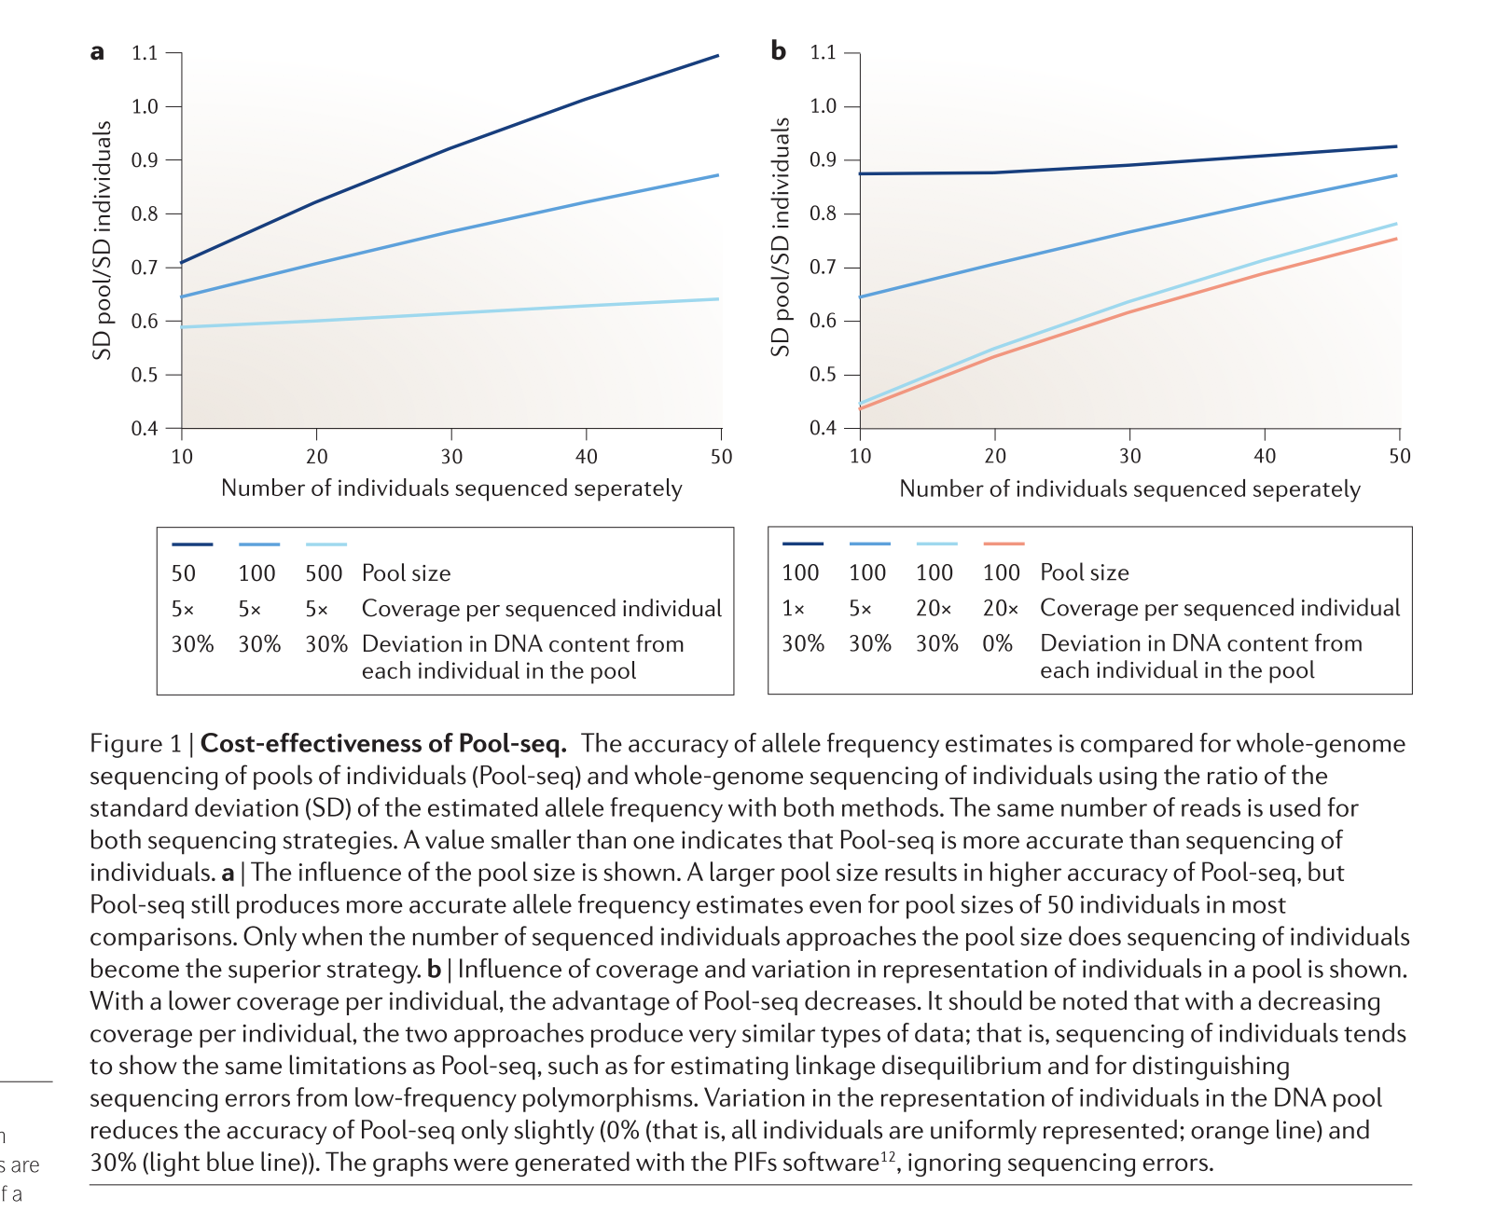
PoolSeq
BIO 594

Slide 38
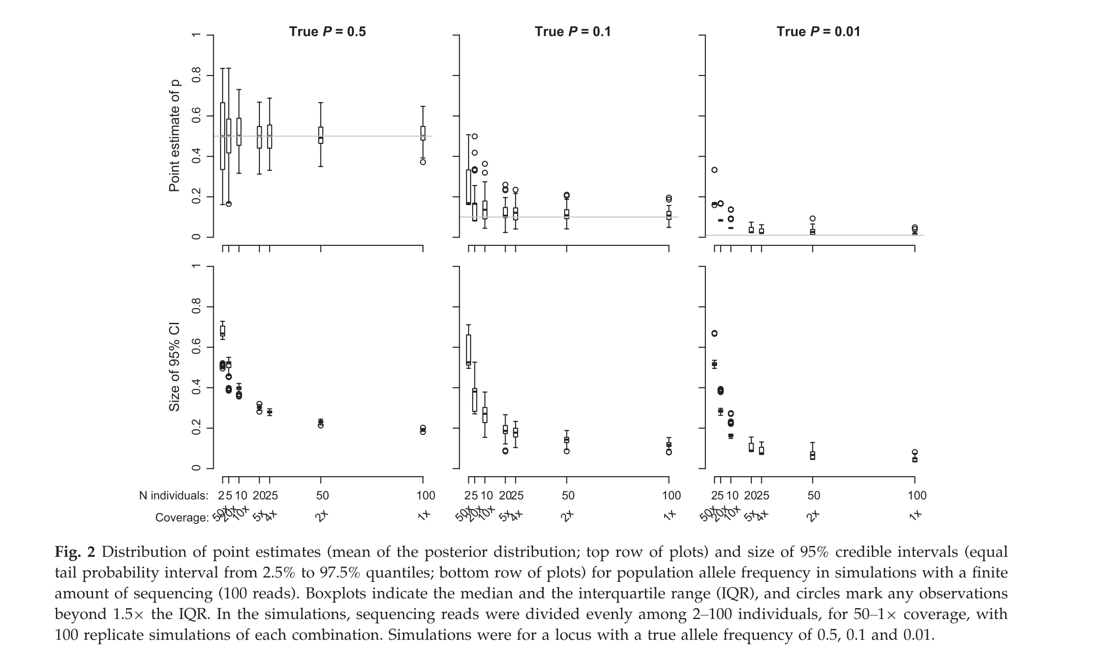
PoolSeq- how low should we go?
BIO 594

Slide 39
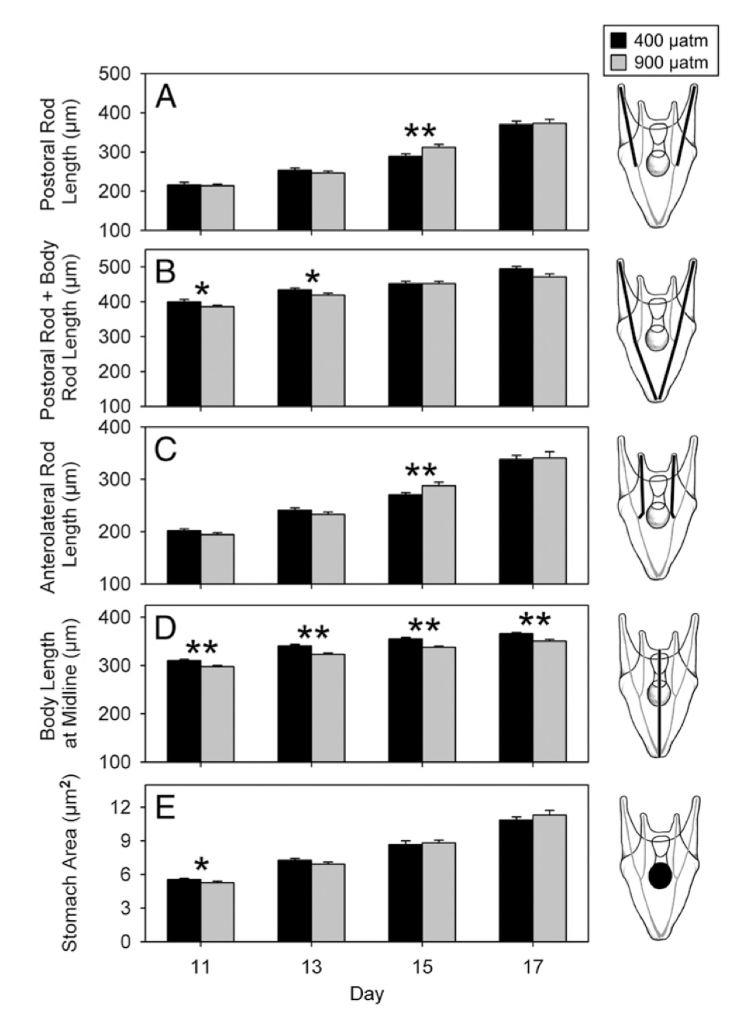
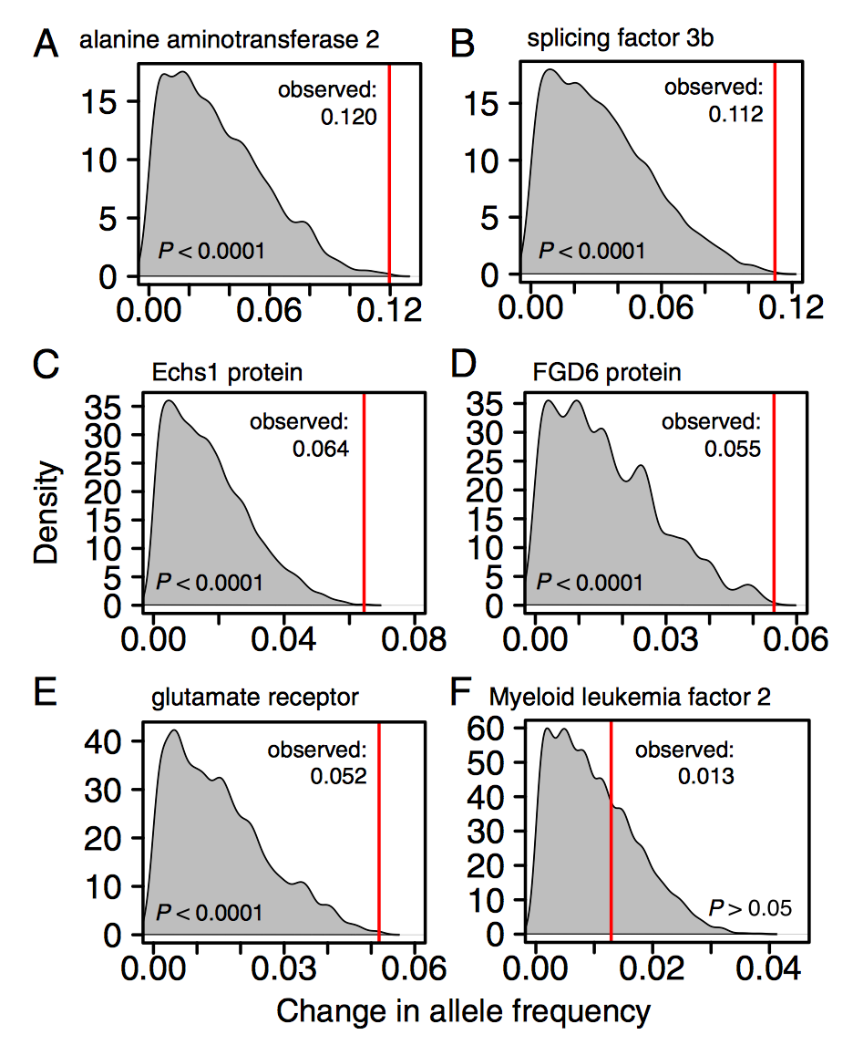
PoolSeq for RNA???????
BIO 594

Slide 40
Low Coverage Whole Genome Sequencing
For this, I am stealing slides from Anders Albrechtsen, one of the authors of ANGSD and expert in this topic
His website can be found: (http://www.popgen.dk/groupWiki/index.php/Anders_Albrechtsen)
BIO 594

Slide 41
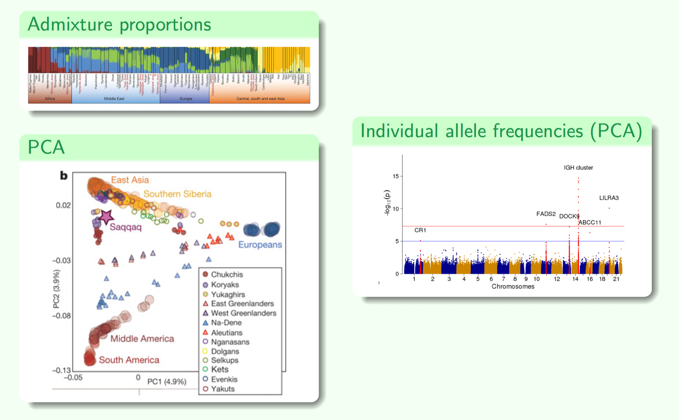
Population genomics with lcWGS
BIO 594

Slide 42
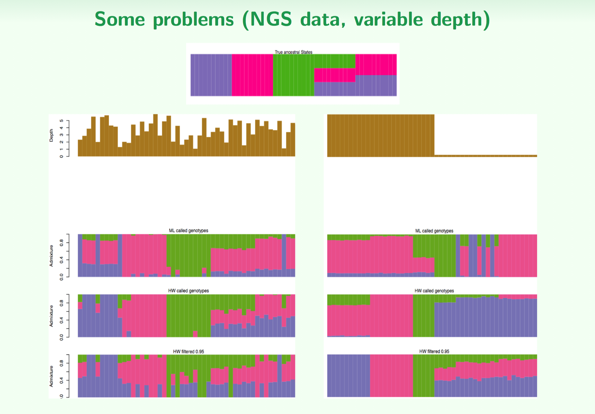
Population genomics with lcWGS
BIO 594

Slide 43
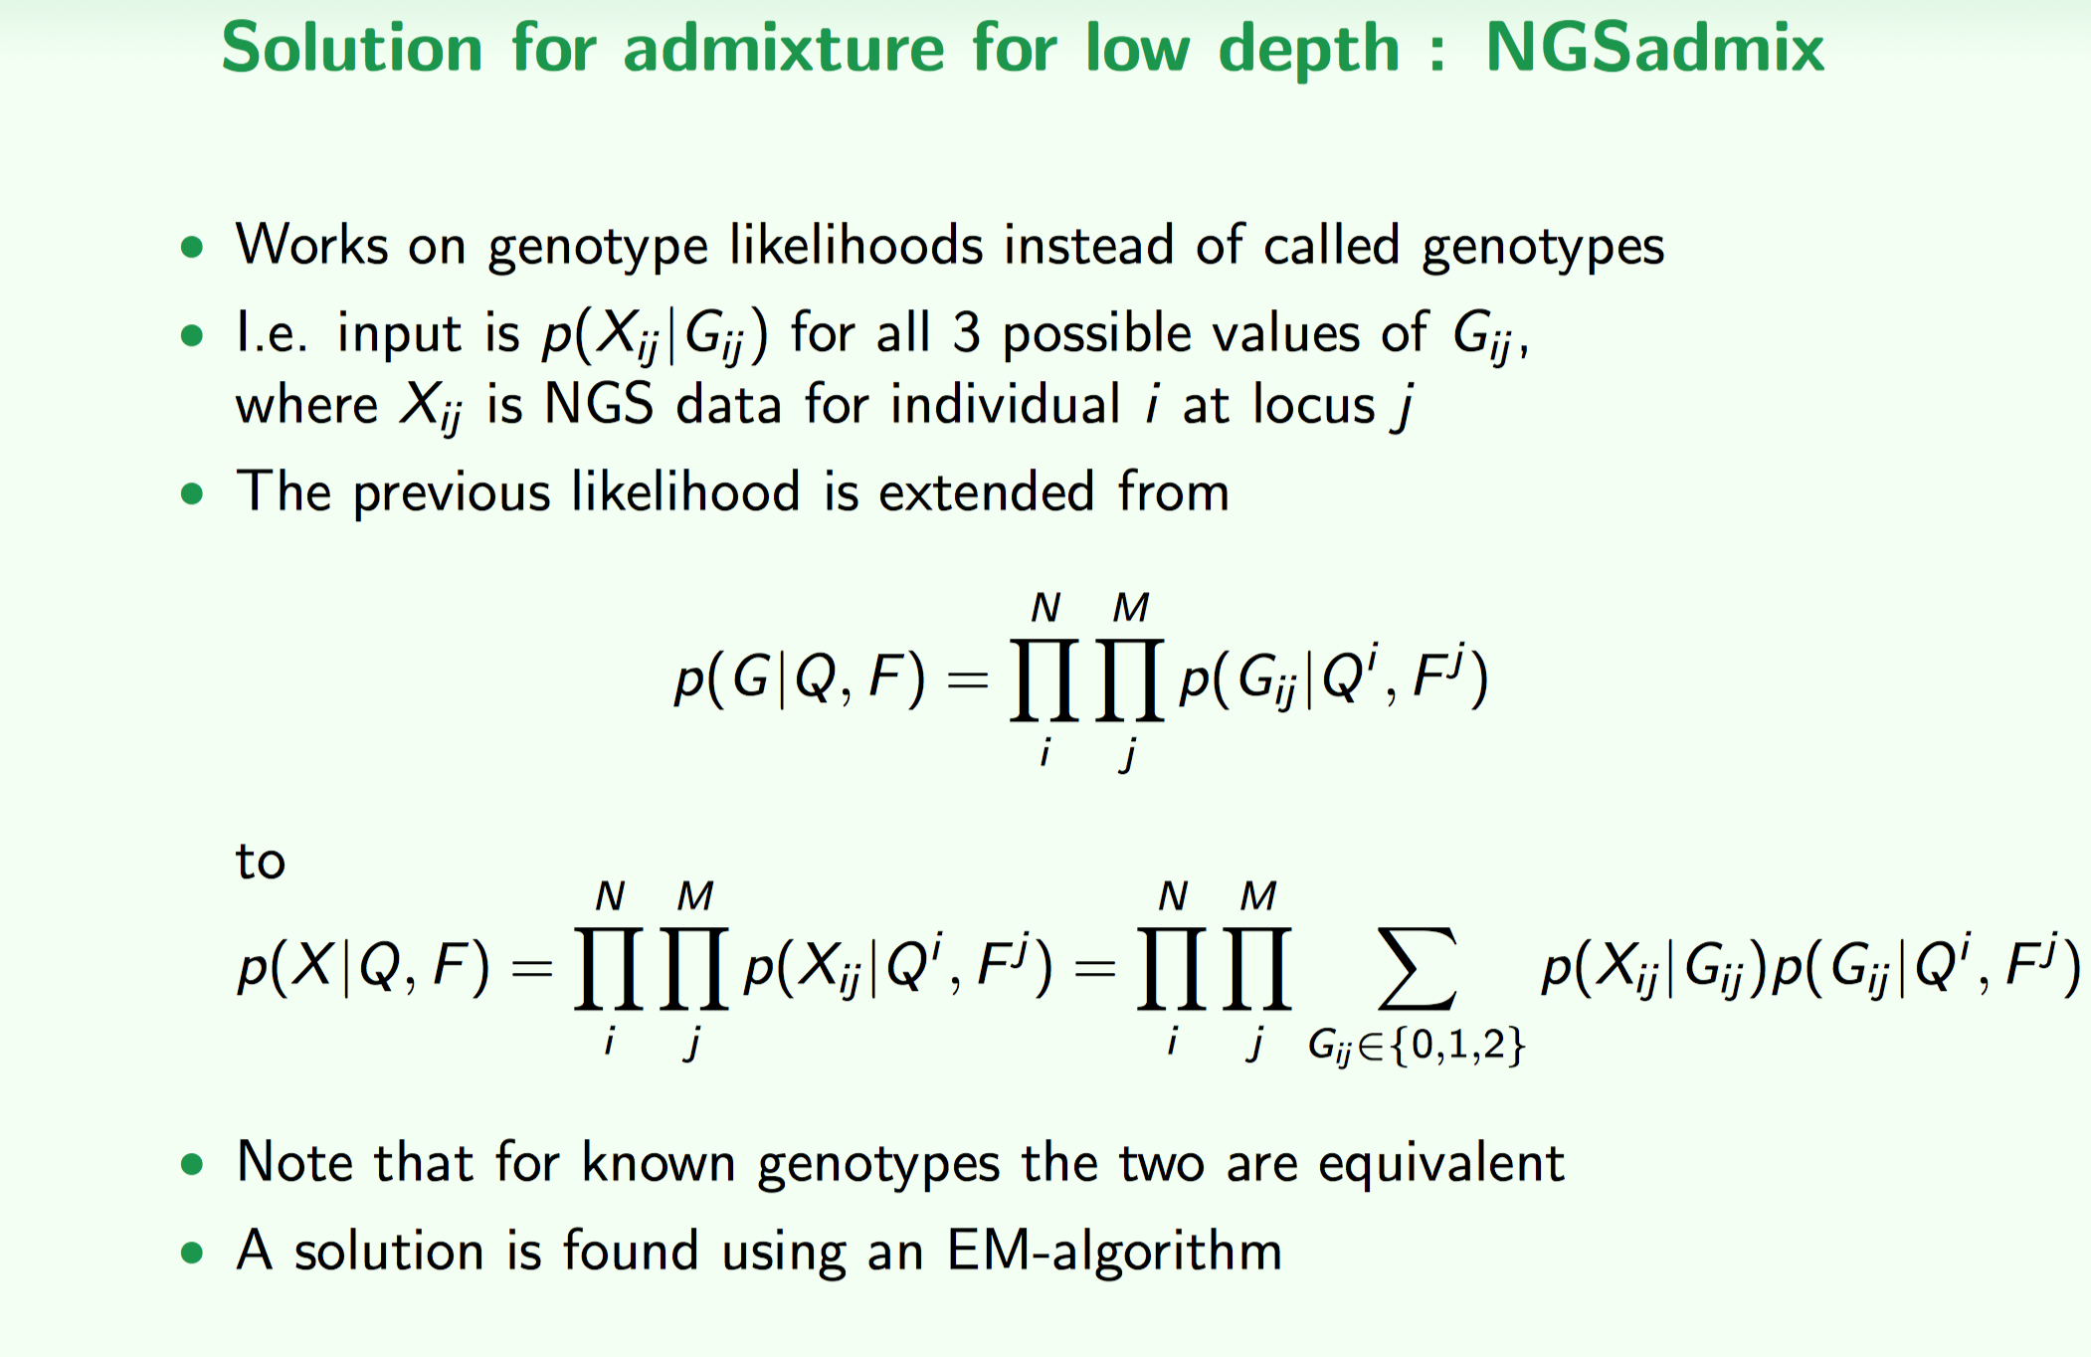
Population genomics with lcWGS
BIO 594

Slide 44
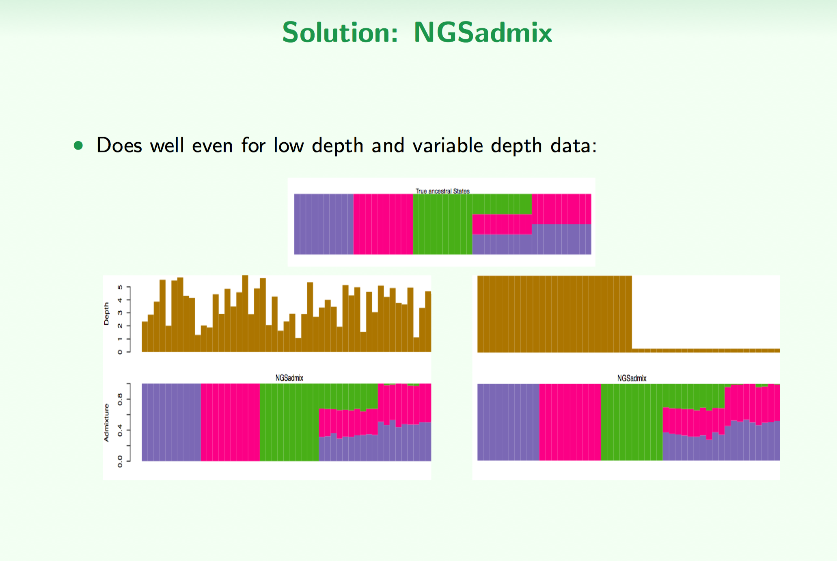
Population genomics with lcWGS
BIO 594

Slide 45
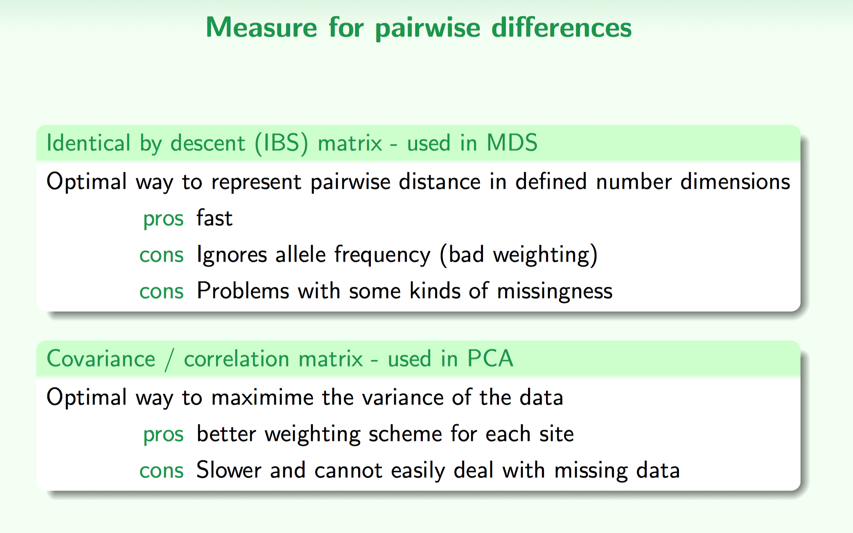
Population genomics with lcWGS: PCA
BIO 594

Slide 46
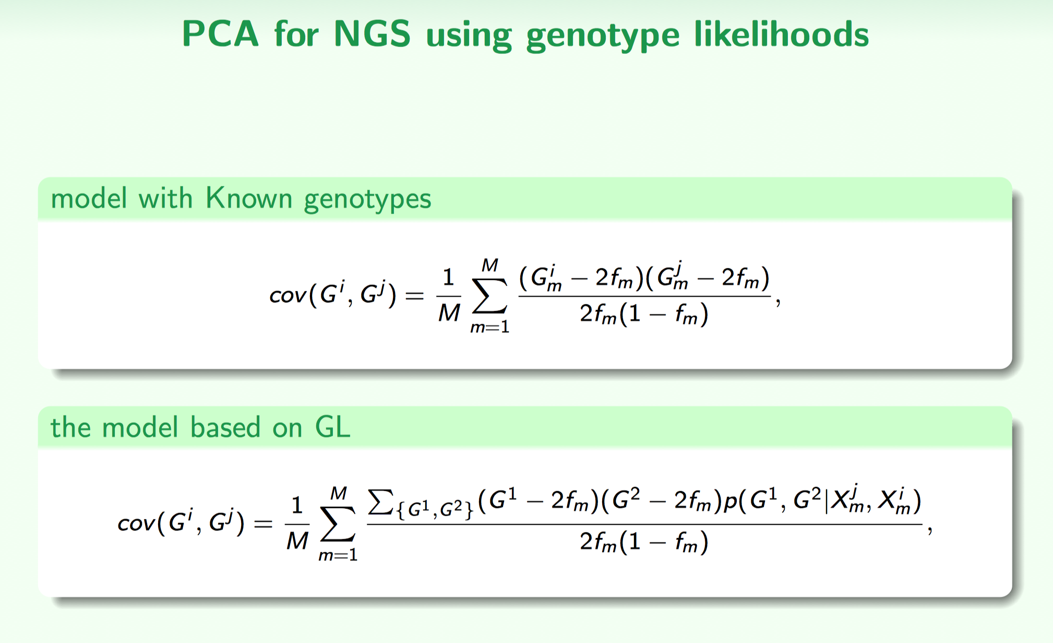
Population genomics with lcWGS: PCA
BIO 594

Slide 47
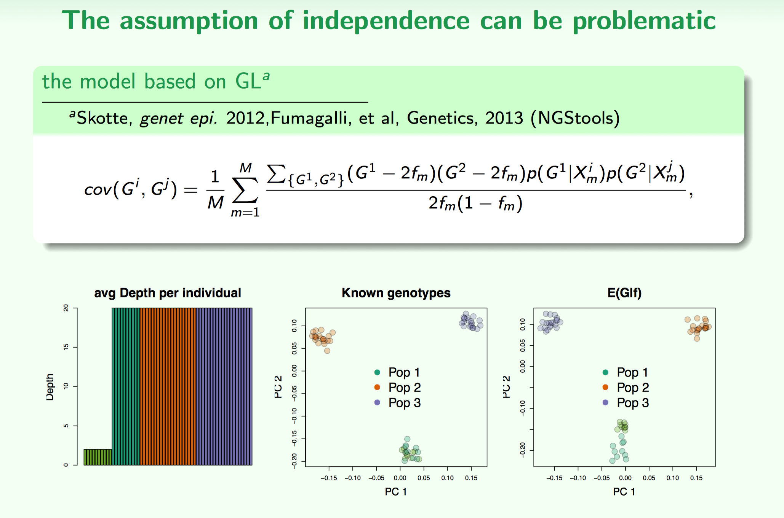
Population genomics with lcWGS: PCA
BIO 594

Slide 48
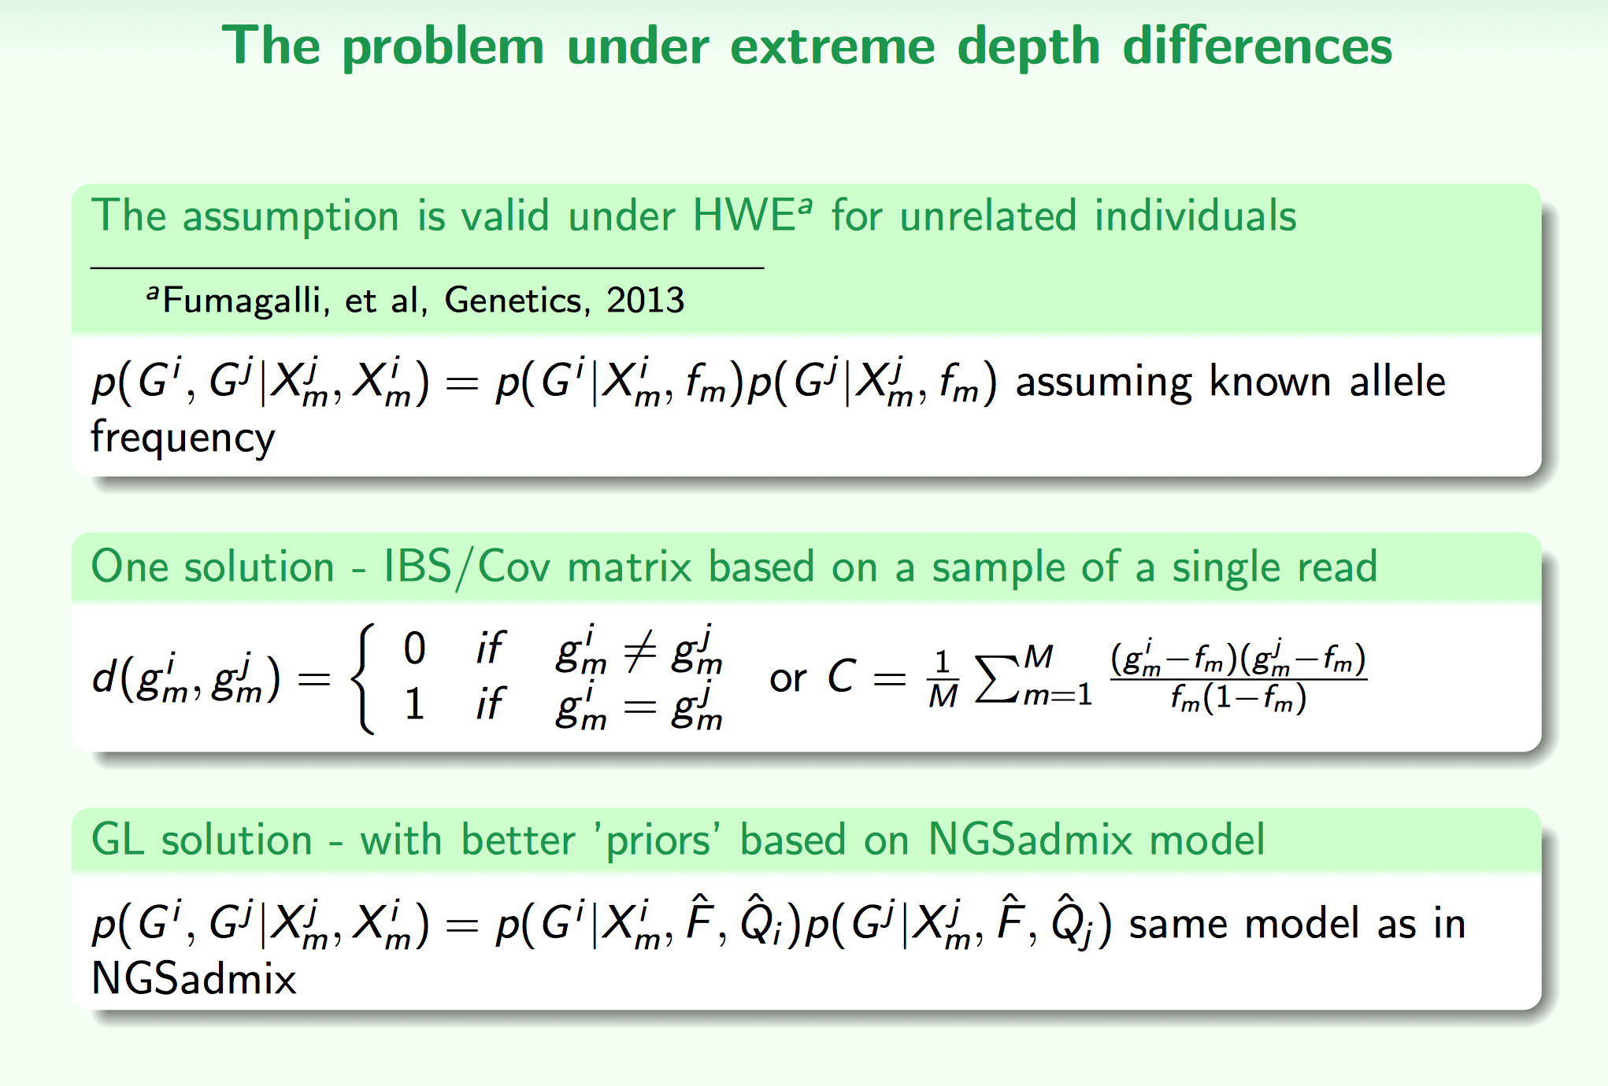
Population genomics with lcWGS: PCA
BIO 594

Slide 49
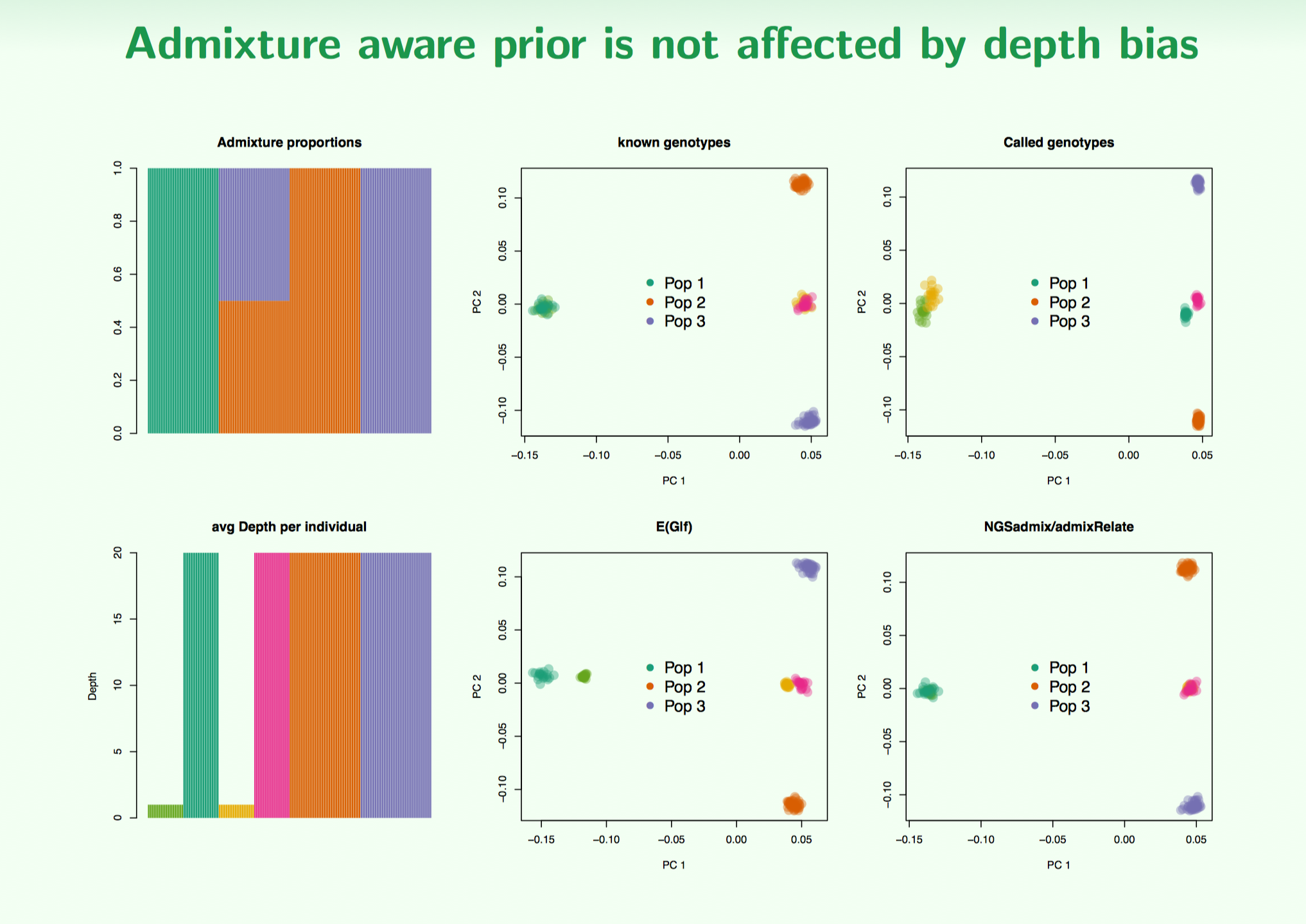
Population genomics with lcWGS: PCA
BIO 594

Slide 50

Population genomics with lcWGS: PCA
BIO 594

Slide 51

Population genomics with lcWGS: PCA
BIO 594

Slide 52

Population genomics with lcWGS: PCA
BIO 594

Slide 53

Population genomics with lcWGS: PCA
BIO 594

Slide 54



Population genomics with lcWGS: PCA
BIO 594

Slide 55

Population genomics with lcWGS: PCA
BIO 594

Slide 56

Population genomics with lcWGS: PCA
BIO 594

Slide 57
Population genomics with lcWGS: PCA
BIO 594

Slide 58
Live Coding and Exercise
Live coding
Explore some exome capture data
EecSeq
Exercise
PCA with low coverage whole genome sequencing
PCangsd
On repository /Exercises/Week10/lcWGS.PCA.md

